Slide 1
Putting your best foot forward on linkedin
Andrea Barton and Liz Babiak

Slide 2

Agenda
About LinkedIn
LinkedIn Stats
How Algonquin Uses LinkedIn
Connect with the College
Build a Great Profile
Expand your Network
Discussion

Slide 3

Who’s on LinkedIn?

Slide 4
Have you visited Algonquin’s Company Page?

Slide 5
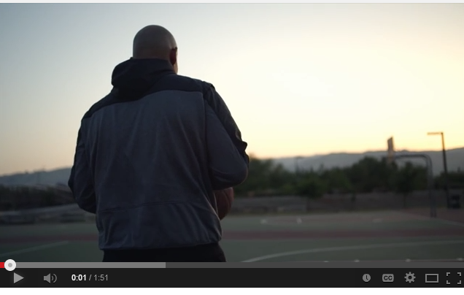
Imagine What We Can Do Together
http://youtu.be/3p9TqRA8APA

Slide 6
About linkedin

Slide 7
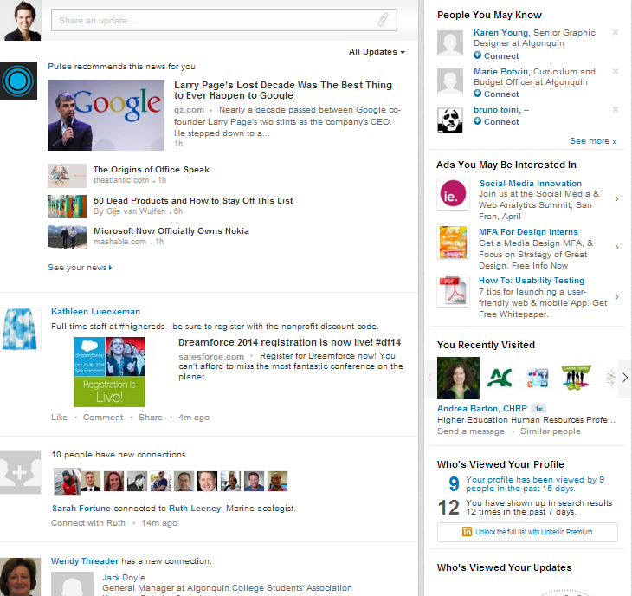
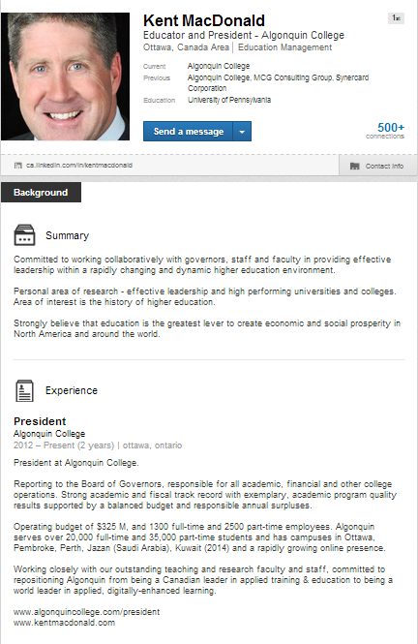
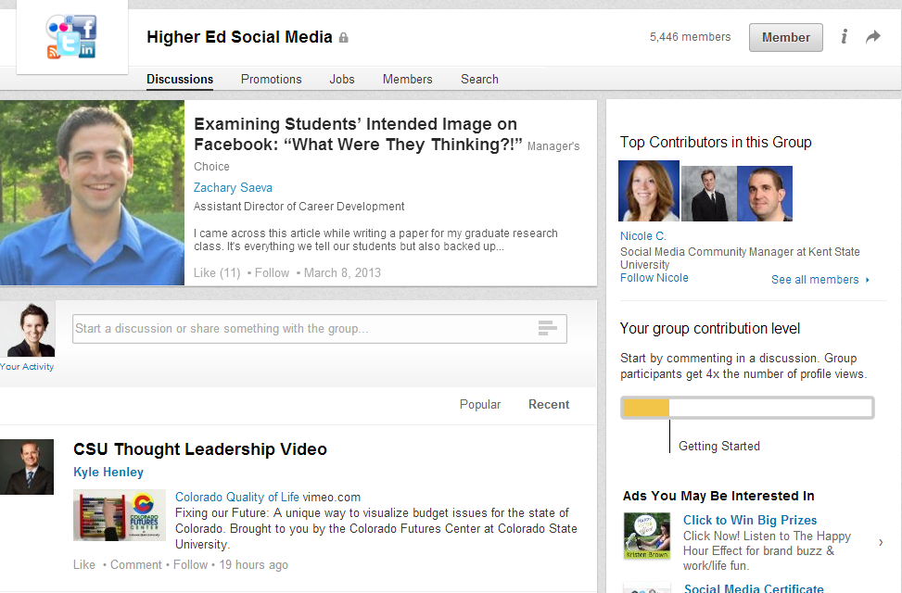
What is LinkedIn?

Slide 8

What is LinkedIn?
Social network for professionals
Not just for job seekers!

Slide 9

Why Does LinkedIn Matter?
Strengthens and extends your network of trusted contacts
You control your profile, it’s
part of your digital footprint
Knowledge sharing +
thought leader positioning
Professional affiliations

Slide 10

Digging Deeper — Who + Why?
Individuals | Employees | Companies | Post-Secondary
Stay in touch | Connect with colleagues + suppliers | Establish/build presence | Connect with alumni and potential students
Get referrals | Research via Groups | Share news and events | Share news and events
Industry news | Industry news | Build a community | Showcase alumni and official groups
Demonstrate expertise |  | Engage with followers

Slide 11



LinkedIn Stats
300 million members worldwide
(200 countries)
Source: Tech Vibes/FixedSocial

Slide 12
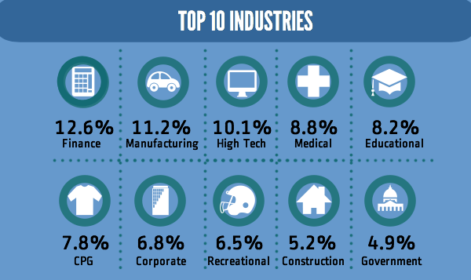
LinkedIn Stats
Source: Tech Vibes/FixedSocial

Slide 13
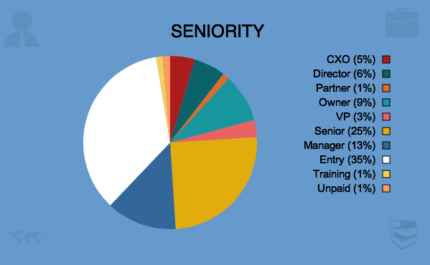
LinkedIn Stats
Source: Tech Vibes/FixedSocial

Slide 14
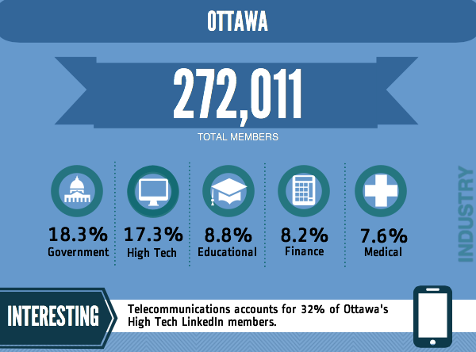
Source: Tech Vibes/FixedSocial

Slide 15
algonquin + linkedin

Slide 16
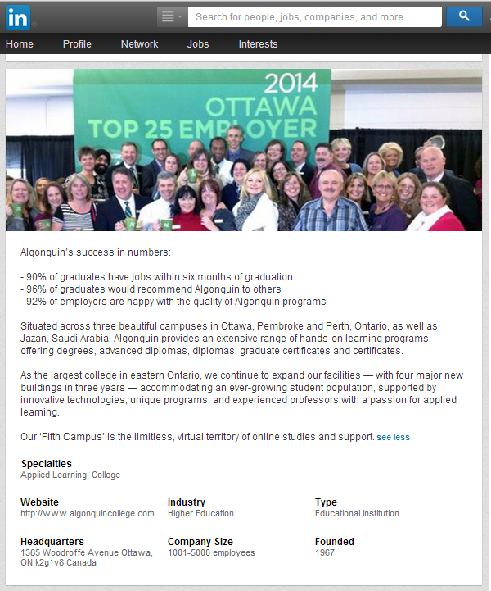
How AC Uses LinkedIn — Company Page
Highlight the College
Showcase AC events
and accomplishments
Facilitate connections
globally

Slide 17
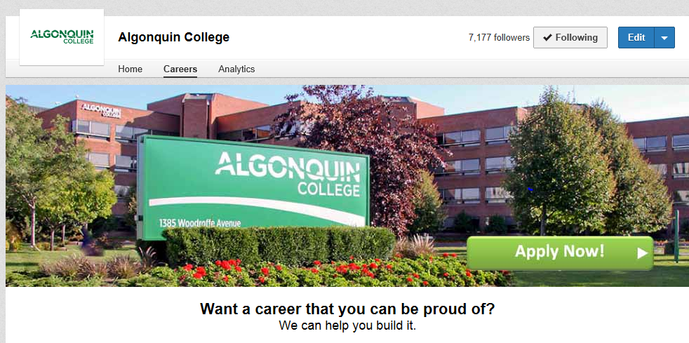
How AC Uses LinkedIn — Careers
Post exciting opportunities
Showcase AC’s culture
Career profiles (coming soon!)
Engage with followers
Recruiting efforts

Slide 18
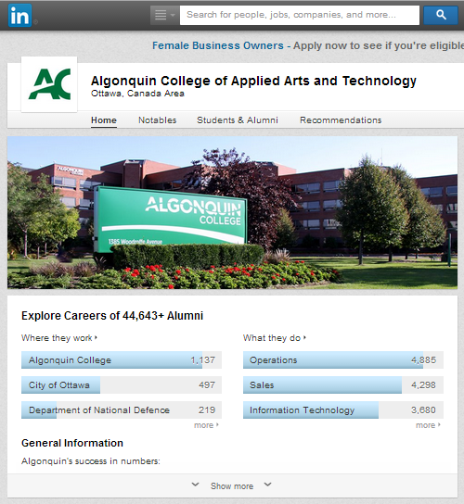
How AC Uses LinkedIn — University Page
Updates for potential students (Why Algonquin?)
Showcase Alumni
  Notable
  Career pathways

Slide 19
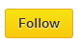
Follow and Share Algonquin
Interact Socially with AC
Receive status updates, jobs posted in your news feed
Share AC’s updates to your network!

Slide 20
Build a great profile

Slide 21
Your Profile: The Basics
Photo → Use a headshot—people want to connect with people
Current Title → Make sure it’s up-to-date
Headline → Sell your strengths/role
Summary → Narrative of key experience
Experience → List present/past jobs + other relevant experience
Skills → Key words + experience

Slide 22
Your Profile: The Next Level
Education + Awards → Keep it relevant
Contact Info → Email, phone, Twitter, website
Add Rich Media → Photos, presentations
Join Groups → Get connected and network
Recommendations → Ask + give
Endorsements → High-Five your network
Updates → Share articles, news, activities

Slide 23
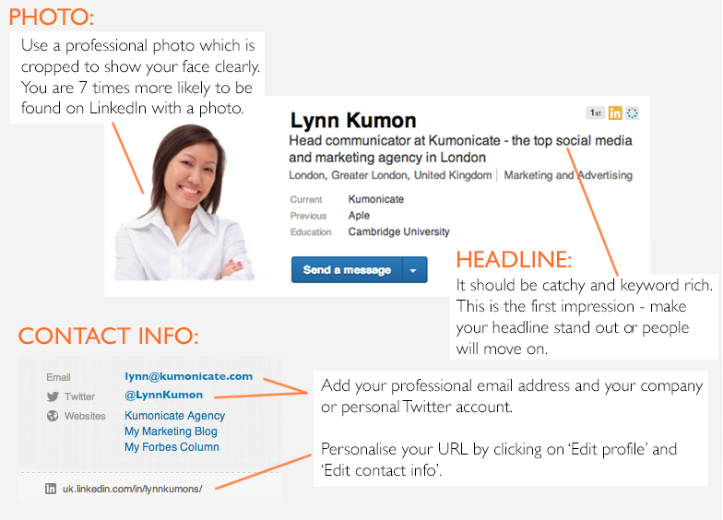
Breaking It Down…

Slide 24
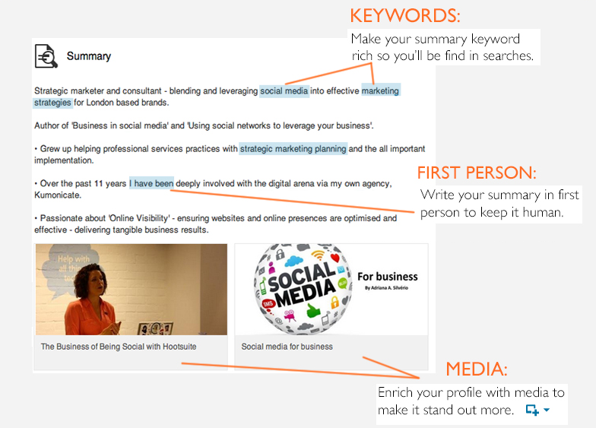
Breaking It Down…

Slide 25
Breaking It Down…

Slide 26
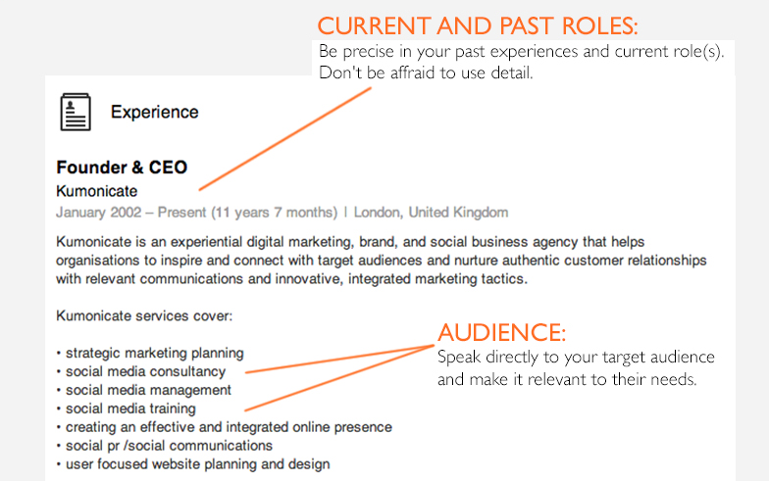
Breaking It Down…

Slide 27
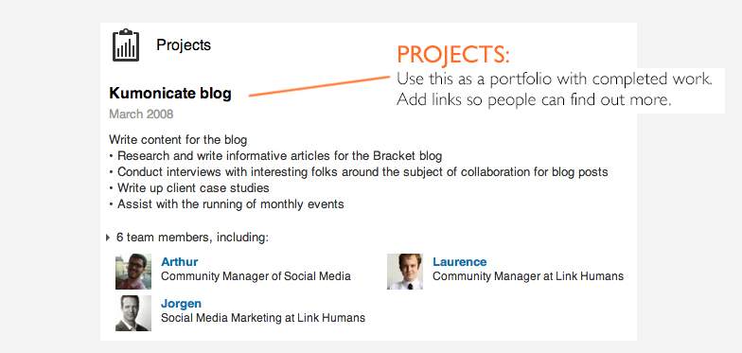
Breaking It Down…

Slide 28
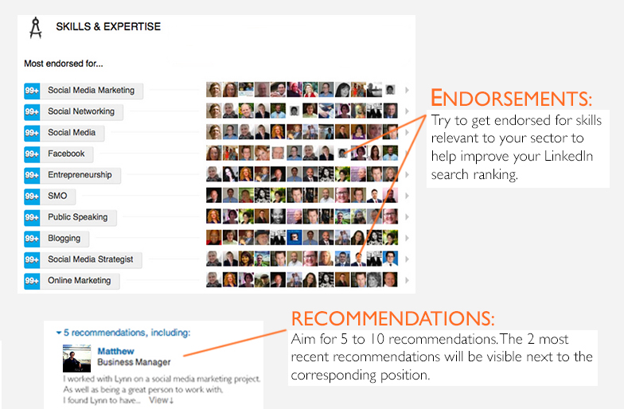
Breaking It Down…

Slide 29
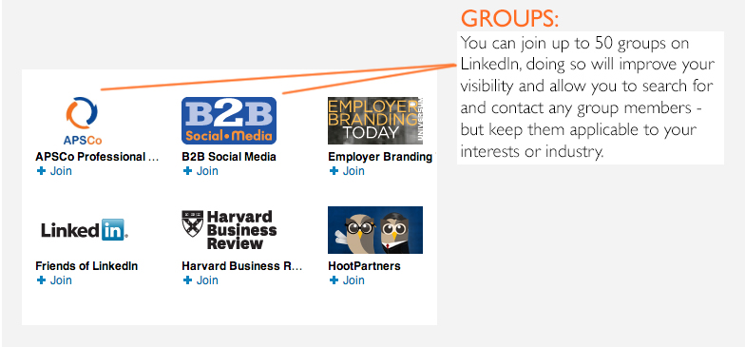
Breaking It Down…

Slide 30

Put Your Best Foot Forward
Keep your profile up-to-date
Treat it like your professional website (Google will!!)
Remember it’s more than a resume
(but a resume nonetheless)
Your chance to sell yourself and network

Slide 31
Expand your network

Slide 32
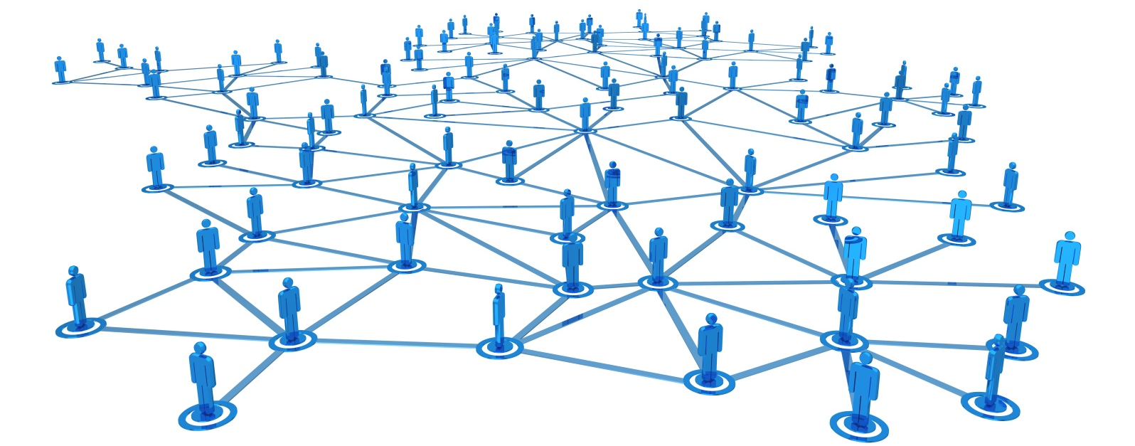
Expand your Network
Find your connections → Past/present colleagues, suppliers, partners
Friends/acquaintances → Can you vouch for them?

Slide 33
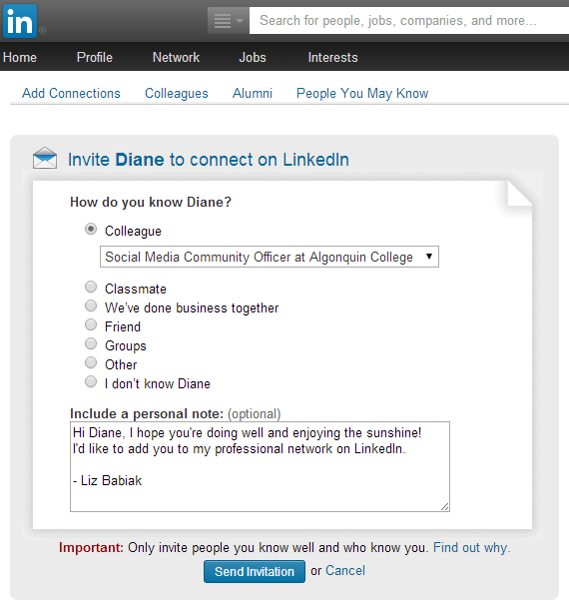
Expand Your Network
Personalize the Connection Invitation
  “Great to meet you today”
  “Hope you’re doing well”
  “So glad we ran into each other again”
  “Remember me?”

Slide 34
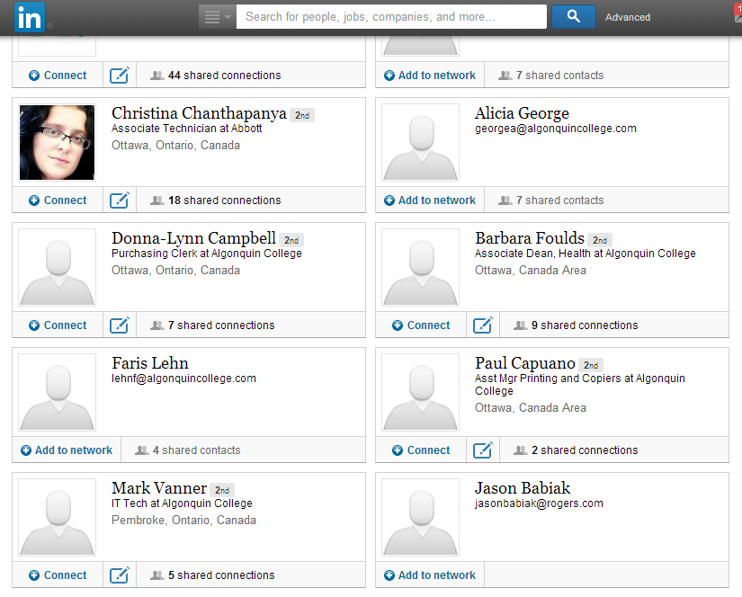
Expand Your Network
Explore “People you May Know” screen after connection requests

Slide 35

Expand your Network
Join Groups → Professional and personal interests, closed/open groups
Share updates and Engage → Establish your knowledge, comment on others’ posts

Slide 36

Personal Considerations
Who will you connect with?
Which groups will you display
on your profile?
Who will you recommend?

Slide 37
Wrapping up

Slide 38
Resources
AC Social Media Hub:
  About LinkedIn & Glossary
  LinkedIn Products
  LinkedIn Stats
  Why Use LinkedIn?
  LinkedIn in HigherEd
  Tips & Best Practices
8 Secrets to Building a Stunning LinkedIn Profile
Getting Started with LinkedIn Groups for Teachers

