Slide 1
Succession/Leadership Development Plan Goals:
Create a leadership candidate pool;
Build the leadership capabilities of internal employees and future leaders through a comprehensive Leadership Development Program

Slide 2
Communications Objectives:
Support Algonquin College’s position as “the employer of choice” by demonstrating its commitment to the growth and success of its employees through succession planning and leadership development;
Position the Succession Planning/Leadership Development Program as an opportunity for those who aspire to a leadership role;
Encourage those interested to self identify

Slide 3
Target Audience:
All Algonquin College employees
  Phase One (Sept 13th – 30th ): Administrative Staff in Supervisory positions
  Phase Two (17th – 31st ): All Staff

Slide 4
Phase One: Supervisor Communications Plan
Phase One: September
  Launch HR and Succession Planning Web sites:
      Positions both the College and the succession planning initiative;
      Explains the process, the Leadership Requirements Model, Self-assessment Tool;
      Answers any potential questions about the program or the process;
      Contains a confidential, automated self- assessment tool and expression of interest form

Slide 5
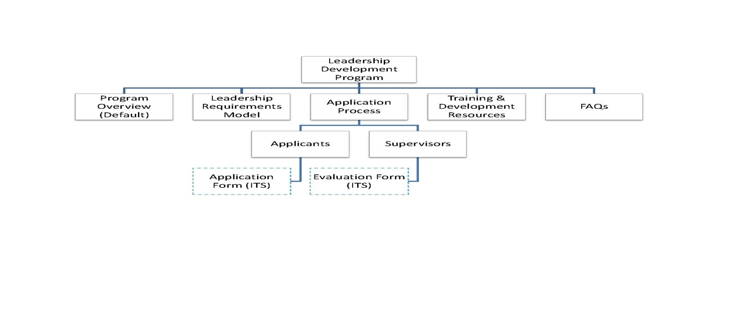
Phase One: Supervisor Communications Plan

Slide 6
Phase One: Supervisor Communications Plan
  Announce initiative on GMA and My Algonquin
  Launch Email series to All Staff
    Position the succession planning initiative
    Explain the two phase approach
  Launch Email series to Administrative Staff in Supervisory positions
    Encourage those who aspire to a leadership role to self identify by driving to the site to register
  Host a lunch n’ learn “What to Expect”, session for those who are interested and want to learn more

Slide 7
Phase Two: All Staff Communications Plan
Phase Two: January
  Announce via GMA and MyAlgonquin
    Feature testimonials/stories from Phase One on MyAlgonquin
  Launch Email series to All Staff
    Encourage those who aspire to leadership development to self identify and drive to site to register
Launch common area posters
Host Lunch n’ Learn
  Info session to educate on the Succession Planning/Leadership Development program, leadership model, self assessment tool and conduct Q&A

Slide 8
Measurement
Measure of Success:
  X # participants in Phase One and X # participants in Phase Two
  Post campaign survey to probe for:
    Positive positioning of Algonquin College as an employer committed to the growth and success of its employees
    Understanding of Algonquin College’s Succession/Leadership Development program, what it is, the process and the commitment required

