Slide 1
WELCOME LEVEL 1 COMMERCIAL VEHICLE OYAP STUDENTS!

Slide 2
WELCOME
Sign in
Get your timetable (which also has your locker assignment)
Grab a campus map
Pick up a copy of your Trade Information Page
Help yourself to a coffee or refreshments along with a cookie/doughnut
Find a free laptop
Enjoy your refreshment and/or treat
We begin at 3:30pm!

Slide 3
You are a College student!
You have been officially registered at Algonquin College
You are similar to any other apprenticeship student, expect that your tuition/course materials/fees have been paid for, and you have some extra people to offer you support
The student number that you have been assigned is YOUR student number for the rest of your time at this College

Slide 4
BUT…you are also a Dual Credit high school student
You have a Dual Credit Support teacher from your school board who can speak with your parents/guardians/home high school and will help you navigate this new environment
You have all of us in the Dual Credit office who will help in any way we can

Slide 5
MAIN TAKEAWAY MESSAGE
This program is supposed to help you TRANSITION
you won’t know everything just yet, but you will learn
There are many, many people who care and are here to help you
BUT WE CAN’T HELP IF WE DON’T KNOW!!!

Slide 6

What is the OYAP program?
https://www.youtube.com/watch?v=I0w3CbUMg7U

Slide 7
Commercial Vehicle
The Commercial Vehicles and Equipment curriculum (CVAE) Level 1 is common in the four trades:
Agricultural Equipment Technician
Heavy Duty Equipment Technician
Powered Lift Truck Technician
Truck and Coach Technician
http://www.collegeoftrades.ca/wp-content/uploads/CTS-COMM_VEHICLEEQUIP_425A.421A.282E.310T_L1.EN_.pdf

Slide 8
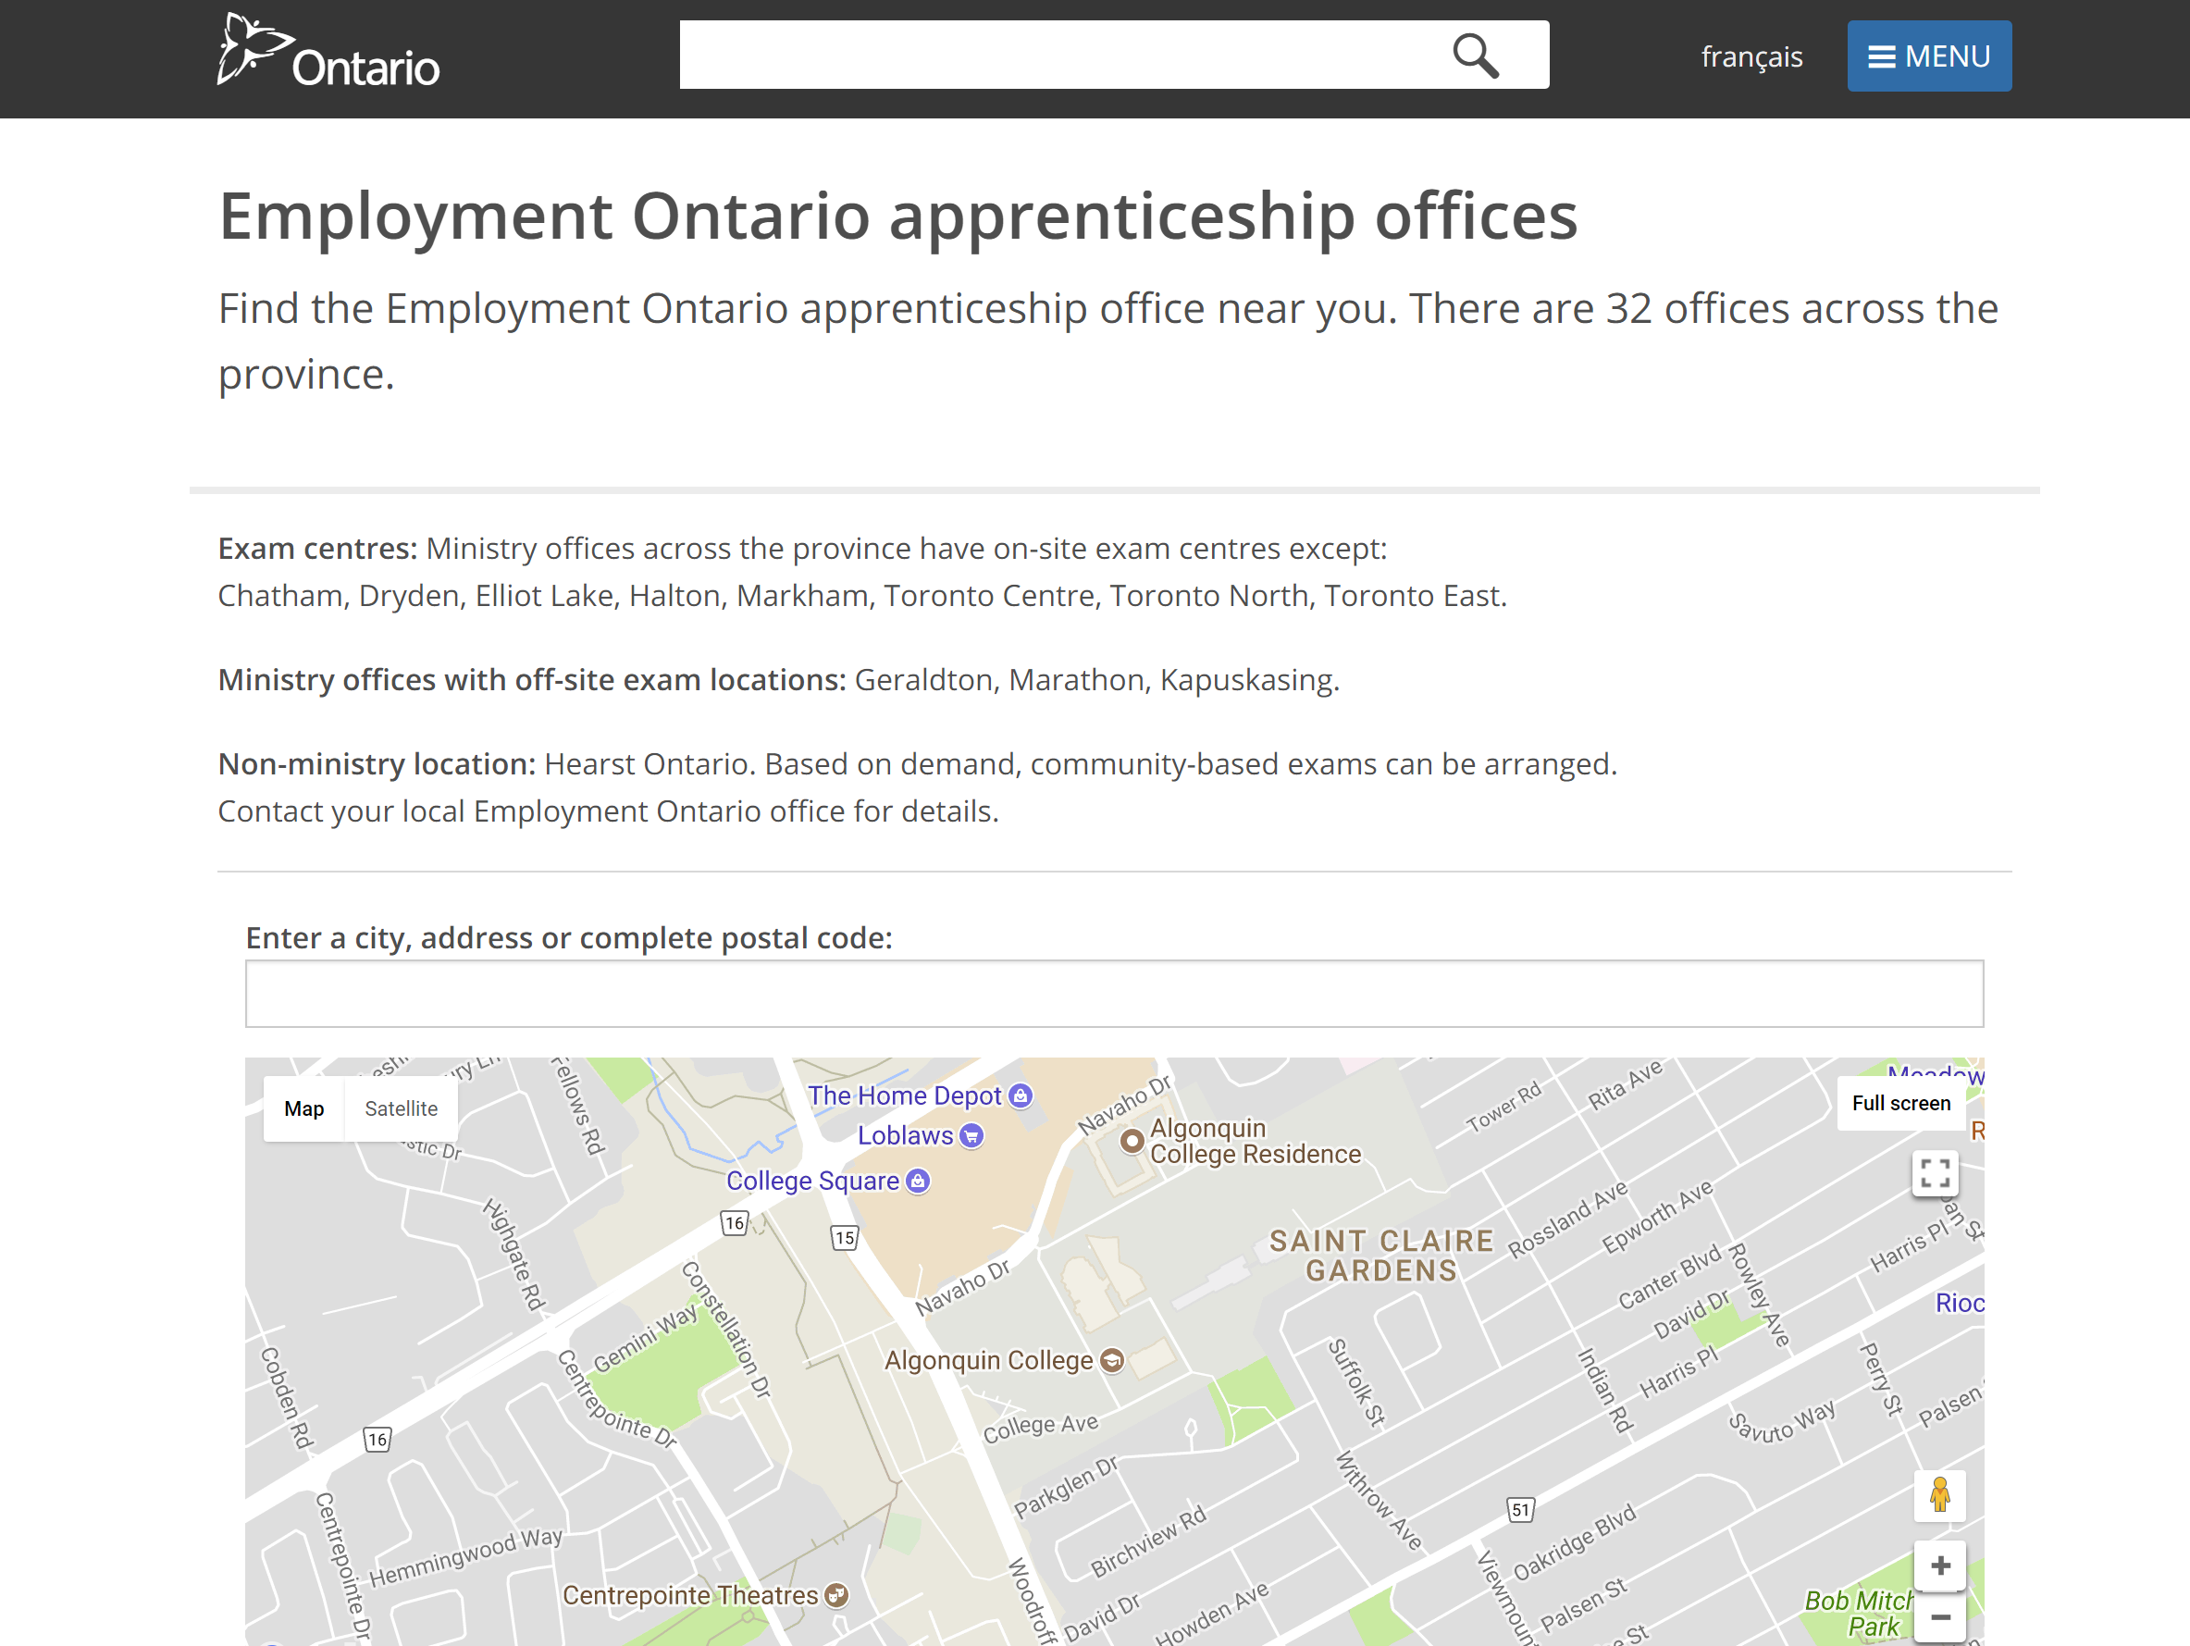
MAESD

Slide 9
Coming to the College…

Slide 10
040-123-456
Diana Curry
1385 Woodroffe Ave.
Ottawa ON K2G 1V8
When
Where
What

Slide 11



Contacting or Visiting the Dual Credit Office
Woodroffe Campus
Room: J213
College Phone #: 613-727-4723
Office Hours: 8:00am - 4:45pm Monday - Friday (or by appointment)
Follow us on:
AcademicPartnerships AC Pathway Explorers
@AlgonquinAP @AlgonquinAP
Academic Partnerships
algonquincollegeap
Kathy Deugo
Logistics & Budget Support Officer
deugok@algonquincollege.com
Ext. 3492
Tracy Norris
Coordinator Dual Credits
dualcredit@algonquincollege.com
Ext. 3497
11

Slide 12
Getting to the College
OYAP students may be eligible for one of the following forms of transportation funding:
Public Transportation:
If you are planning to bus to your classes, please purchase a Presto Pass load monthly – bring the receipt to J213 for reimbursement.
Personal Vehicle:
If you are planning on driving to your classes, please provide me with the Make/Model/Plate Number of the vehicle you will be taking.
You will be provided with a parking pass for Lot 12
Eligible for mileage IF high school is 10km or more away from the campus ($0.20 a km, round trip) – fill out form monthly in J213
Lost passes/Presto Cards cannot be replaced by Academic Partnerships Office and it would therefore be the responsibility of the student to cover this cost

Slide 13
Getting to the College
Questions? Concerns? Financial need? Unique situation? Please speak to or email the Dual Credit Coordinator and a decision will be made on a case by case basis.
dualcredit@algonquincollege.com

Slide 14
Course materials
You have been assigned a locker for the duration of your course
  The locker number and combination is the white sticker on your timetable
You’ve been given a textbook – it is yours to keep
Safety glasses will be brought to your class
You are required to supply/bring your own safety boots
  You should have already from co-op. Reimbursed by DSB
You are also required to be properly dressed for the lab (or you won’t be permitted to enter)
  Long sleeves, long pants, thick pants, safety boots, safety googles (no track pants), and anything else the instructors tell you on day 1!

Slide 15
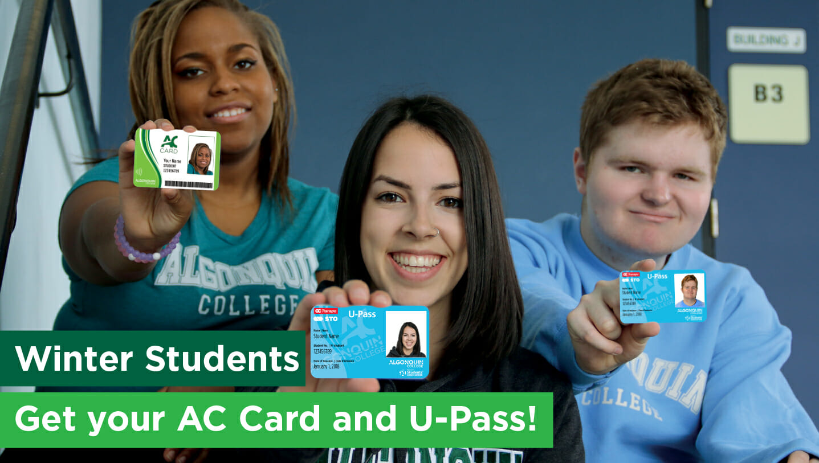
Student ID
Submit your photo online
Visit E120 in person

Slide 16
Student ID – Online Submission
Visit http://www.algonquincollege.com/card-services/
Select “Submit a photo online for my AC Card & Upass”
Scroll down to “Submit photo online now!”
You will be asked to log in with your Network ID
Follow the directions
Pick your card up in E120

Slide 17
Student ID – In Person
Visit E120 – bring your timetable and a piece of government issued photo ID

Slide 18
College Technologies
  Student # and birthdate
    ACSIS
  Network Account = EVERYTHING ELSE
    Blackboard
    Live@AC - email
    WIFI
    Other log ins

Slide 19
ACSIS – Algonquin College Student Information System
  On this you can find:
  Timetable
  Grades
  GPA
  Financial Management

Slide 20
ACSIS – Algonquin College Student Information System
Go to www.algonquincollege.com and select “Current Students”
**This should be along the top of the page in a black bar

Slide 21
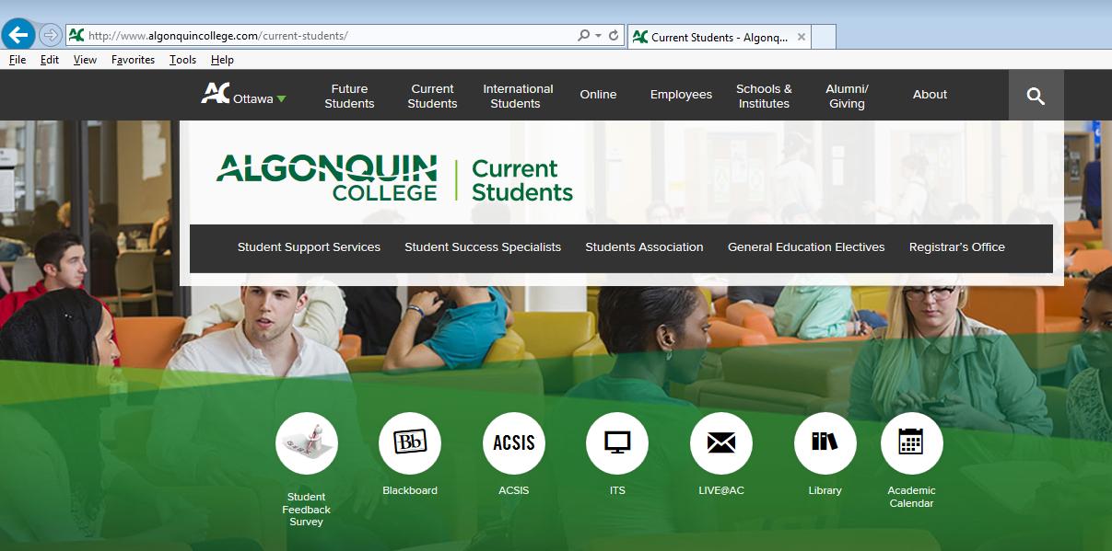
ACSIS – Algonquin College Student Information System
Select “ACSIS”

Slide 22
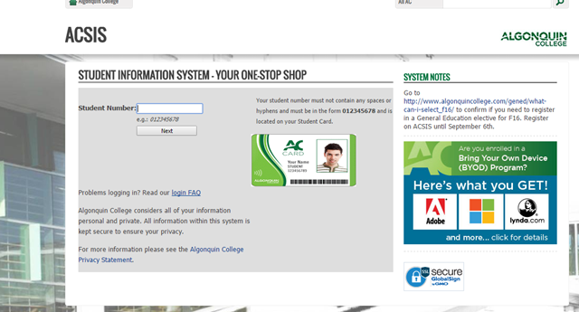
ACSIS – Algonquin College Student Information System
Enter your student number with no spaces or hyphens.

Slide 23
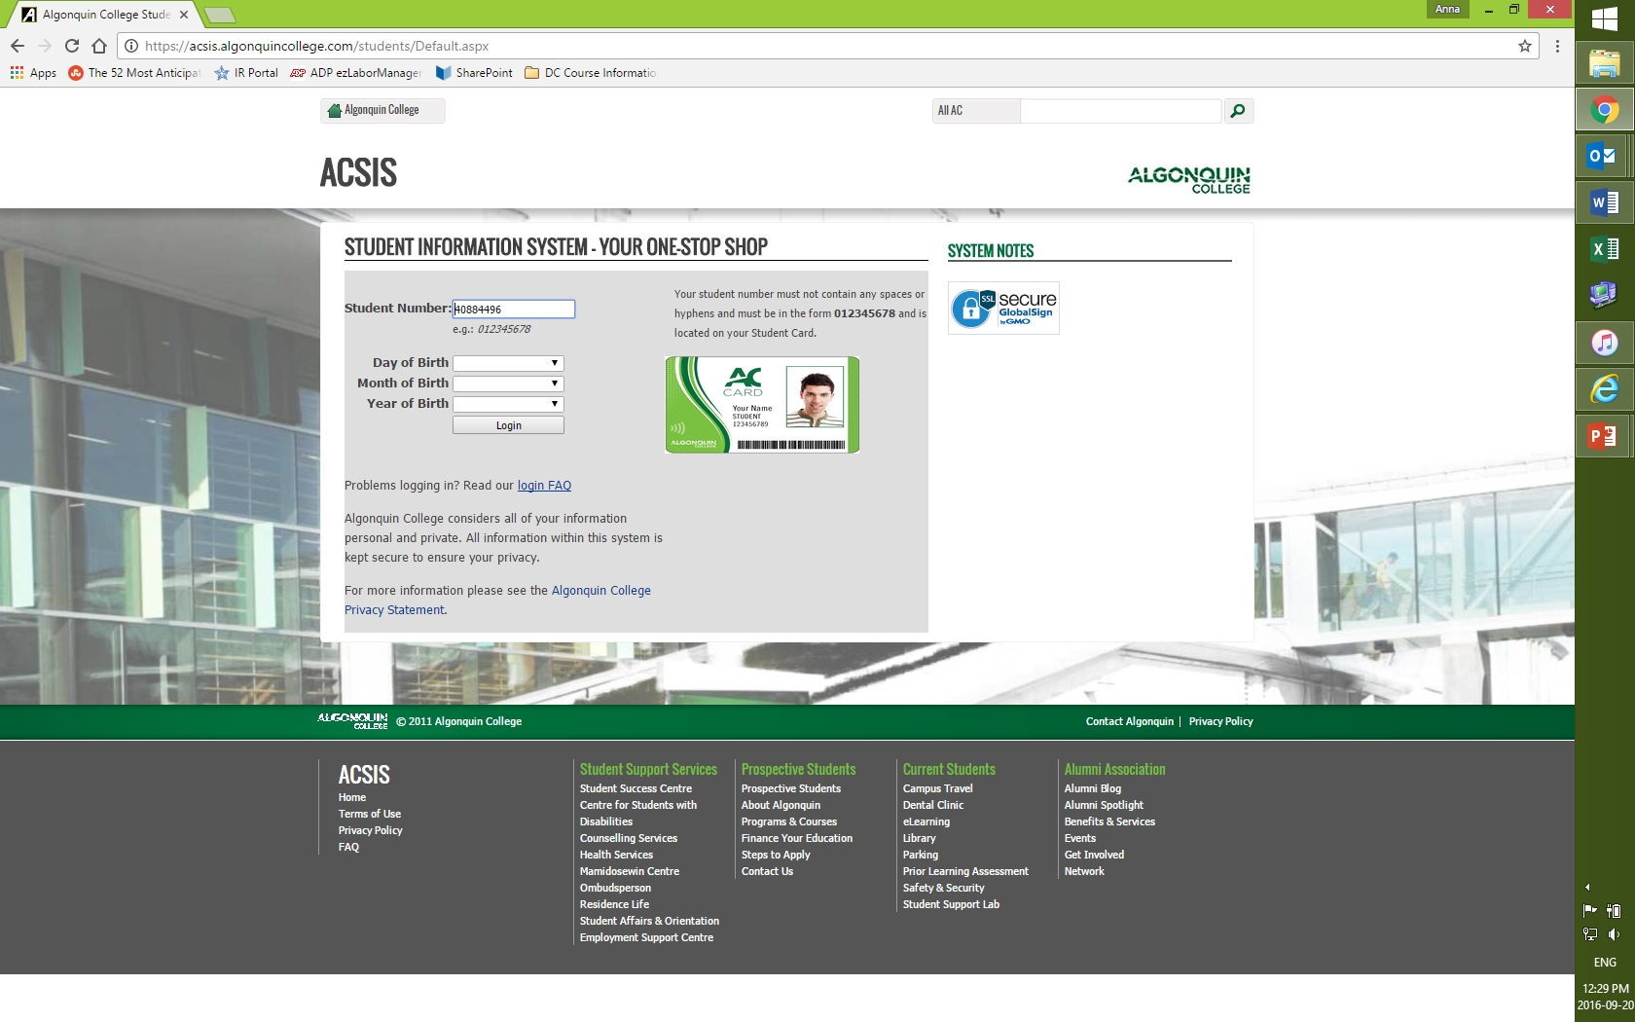
ACSIS – Algonquin College Student Information System
You will be asked to input your date of birth to verify that it is you. You will only have to do this the first time you log in.

Slide 24
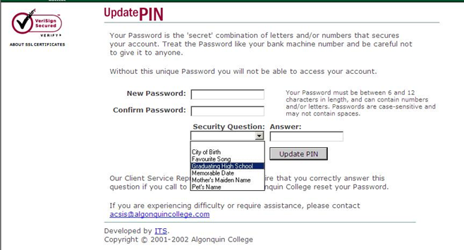
ACSIS – Algonquin College Student Information System
Create a password for this account.
Select and answer a security question.
**This answer will be case-sensitive.

Slide 25
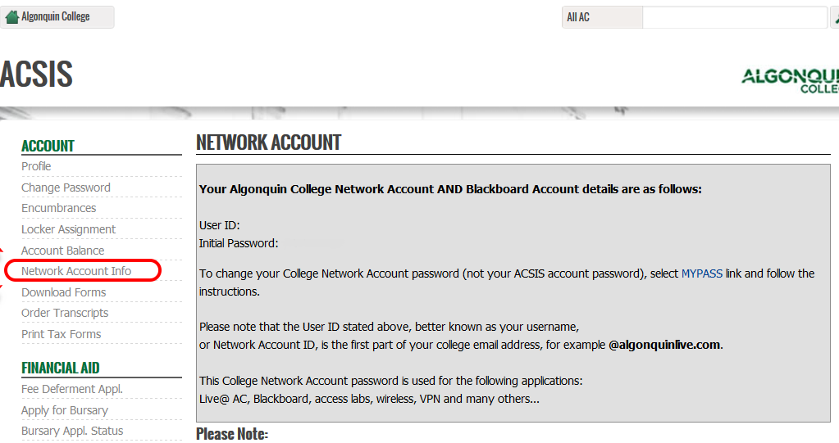
ACSIS – Algonquin College Student Information System
On the left side of the screen is “Network Account Info”
This is where you find your Network ID and Password.
Write this down/take a picture with your phone.

Slide 26
ACSIS – Algonquin College Student Information System
Your network ID is the first four letters of your last name and a series of four numbers.
Your password is a lowercase “y” and an uppercase “A” followed by six numbers. This is case sensitive.
Your network ID is also your email address:
networkID@algonquinlive.com

Slide 27
ACSIS – Algonquin College Student Information System
Other Uses for ACSIS
Downloading another copy of your timetable
Retrieving your final grade two weeks after your course is finished
Locker and bursary information for full time students
Apply for an exemption/Transfer of Credit

Slide 28
Blackboard
Blackboard is the Learning Management System used by Algonquin College.
Place for faculty and students can communicate and collaborate
Course outlines, materials, assignments etc will be shared through Blackboard by your instructor.
Check this several times a week for important updates.
Download the Blackboard app for your smartphone for instant notifications of additions to your Blackboard.

Slide 29
Blackboard
Go to www.algonquincollege.com and select “Current Students”
**This should be along the top of the page in a black bar

Slide 30
Blackboard
Select “Blackboard”

Slide 31
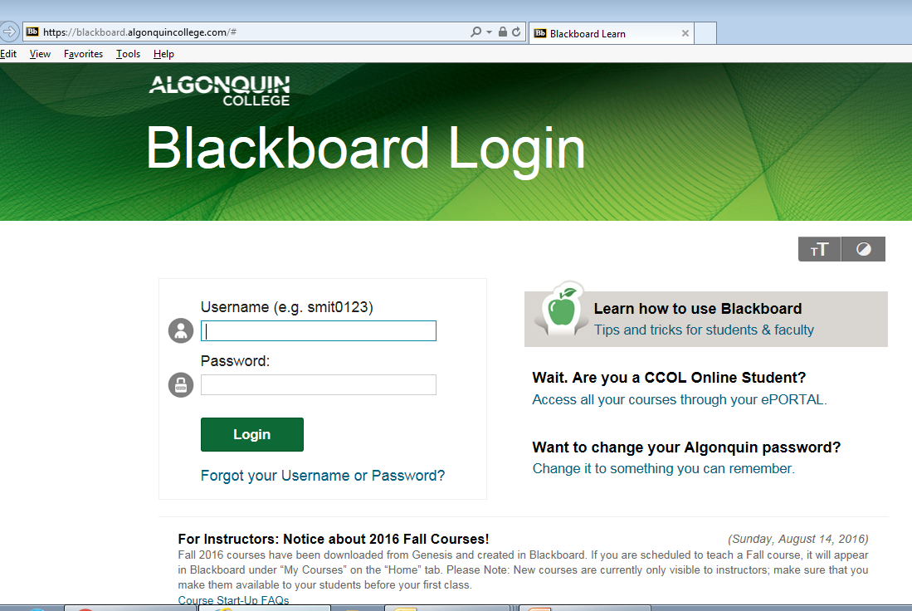
Blackboard
Log in using the Network ID and password you retrieved from ACSIS

Slide 32
Blackboard
On the right hand side of the screen are the courses you are enrolled in.
Each course will look different based upon the instructor – they can customize it for the course.
You will find a course outline, communication methods to get in contact with your instructor.
Also available are student resources (videos and tutorials on various applications that will set you up for success as a student)
TAKE TIME TO EXPLORE YOUR BLACKBOARD!!!

Slide 33
LIVE@AC
LIVE@AC is your Algonquin College email.
Your email address is your Network ID (the one from ACSIS) – networkID@algonquinlive.com
This is what your instructor will use to communicate with you. Check it often.
The College will also send important information to this account. The College will not send things to your personal email account.

Slide 34
LIVE@AC
Go to www.algonquincollege.com and select “Current Students”
**This should be along the top of the page in a black bar

Slide 35
LIVE@AC
Select “LIVE@AC”

Slide 36
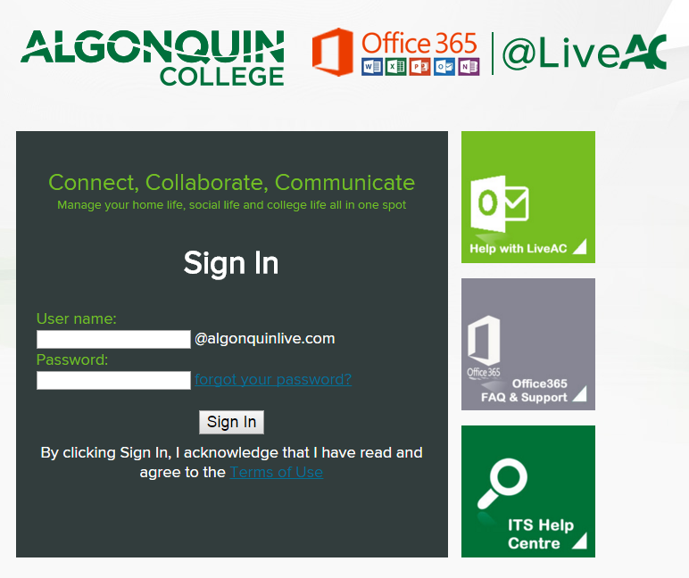
LIVE@AC
Your username is the Network ID from ACSIS
Your password is the “yA” password – also from ACSIS

Slide 37
LIVE@AC
You will be asked to select a language preference and a time zone. You will only be asked to do this once – the very first time you log in.
**We are “Eastern Time”

Slide 38
LIVE@AC
This email platform is the same as Windows Live – if you have a Hotmail email account, you must be logged out in order to log into LIVE@AC

Slide 39
WIFI
To connect to the internet at Algonquin, select “ACSecure” on your device.
The log in is your Network ID and password.

Slide 40
Student Support
Aka Who can I go to for help?

Slide 41
Who can I ask for help?
Professor
Dual Credit Support Teacher
Office of Academic Partnerships – J213
Academic Advisors/Success Specialists
  Gord McGregor
AC Student Support Services
HS Co-op teacher
Parent/Guardian/Family
Other students in the Level 1

Slide 42


Support Services
All support services available to Algonquin College students are also available to Dual Credit students. This includes:
Student Success Specialists
Academic Advisors
Counseling
Mamidosewin Centre
Queer Students’ Alliance
Student Learning Centre
Library
Centre for Accessible Learning
Employment Support Centre
Ombusman’s Office
Student’s Association
Health Services
Student Success Specialist
Academic Referral Advisors
AC Hub
And others!
Visit J213 or email dualcredit@algonquincollege.com to receive more details

Slide 43

Parting message…

Slide 44
Questions?
Then mini-tour!

