Slide 1
Year End Journal Entries
Presentation to the Finance Support Working Group
February 17th, 2022

Slide 2

Agenda
1. Year End Journal Entries
2. Process for Submission of Year End Journal Entries
3. Key Dates

Slide 3

Year End Journal Entries – what are they and how are they different?
Accrual and deferral entries that will reverse out the following month
Submitted directly in Workday
Approvals in Workday

Slide 4

Categories of Year End Journal Entries
Expense Accruals
Revenue Deferrals
Prepaid Expenses
Revenue Receivable

Slide 5
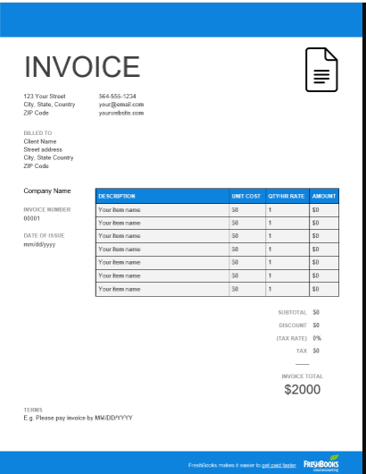
Categories of Year End Journal Entries
1. Expense Accruals
Expense incurred in fiscal year but not yet recorded in ledger
Some invoices will be accrued automatically – PO with receipt
Offset to Accrued Liabilities - ledger account 2080
Backup: copy of invoice with relevant details highlighted

Slide 6


Categories of Year End Journal Entries
2. Revenue Deferrals
Received funds in current fiscal year for revenue that will be earned in next fiscal year
Offset to Deferred Revenue - ledger account 2500 with additional work tag (Deferred Revenue – Contracts, Other, MTCU Contracts, Contracts – Related Entities)
Backup: Workday cost centre rollup up report, excerpt of contract showing relevant details

Slide 7

Categories of Year End Journal Entries
3. Prepaid Expenses
Expense paid for in advance, before
receiving the goods or service
Common with leases, service agreements, software licenses
Offset to Prepaid Expenses Operating - ledger account 1500
Backup: invoice with indication of period of time covered, ledger details showing amount booked

Slide 8

Categories of Year End Journal Entries
4. Revenue Receivable
Revenue earned in current fiscal year but
funds not received by year end
Offset to AR MTCU - ledger account 1230 or Other Accounts Receivable – ledger account 1370
Backup: Workday cost centre rollup report showing expenses incurred, excerpt from contract indicating amount of funding to be received in current fiscal year

Slide 9
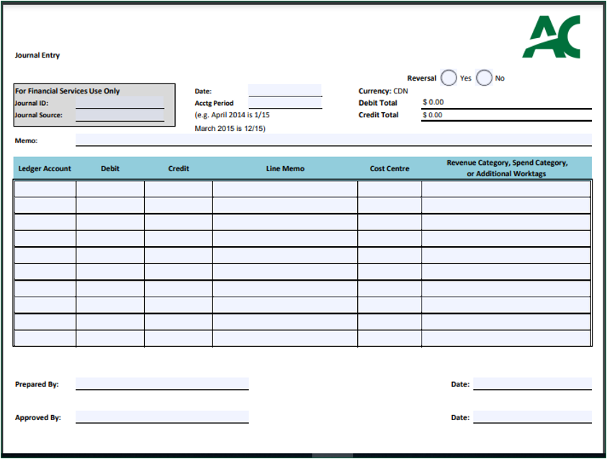
Submission Process for Year End Reversing Accrual Journal Entries
BEFORE

Slide 10
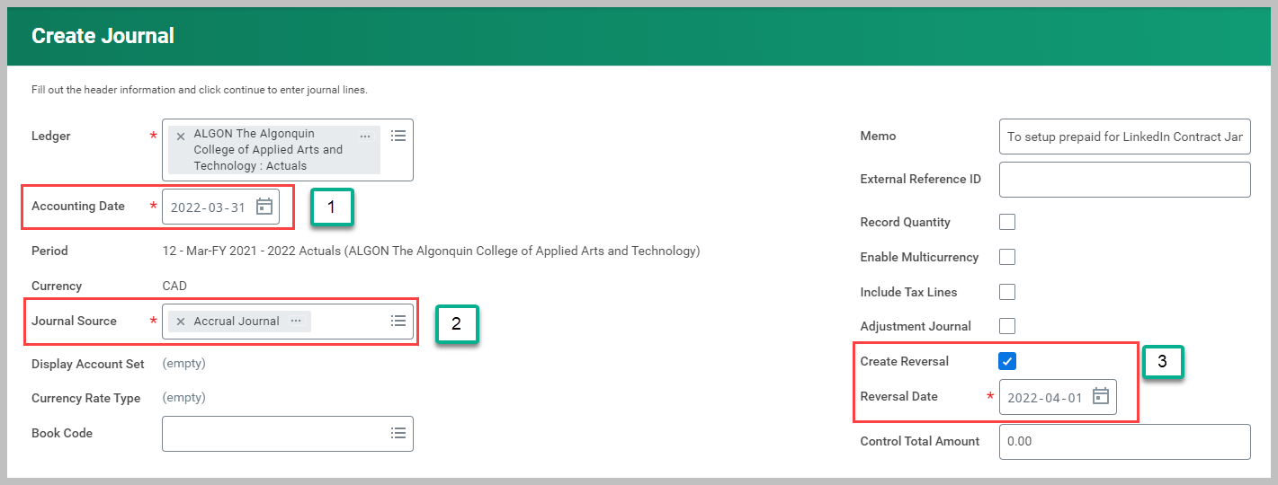
Submission Process for Year End Reversing Accrual Journal Entries
The journal entry will now be entered and submitted directly in Workday where it will follow the approval process
The only changes:
  1. Accounting Date = March 31 2022
  2. Select Accrual Journal source
  3. Click on Create Reversal

Slide 11
Summary Table – Ledger Account and Worktags for Year End Accrual Entries
Journal Entry Category | Offset Ledger Account to Use | Worktag (if needed) | Appropriate Backup
Expense Accrual | Accrued Liabilities – ledger account 2080 | No Worktag Needed | Invoice copy Confirmation that good / service was received in fiscal year but not yet recorded in ledger Amount of invoice clearly indicated including portion of non-refundable HST at 3.41%
Revenue Deferral | Deferred Revenue – ledger account 2500 | Deferred Revenue – Other Deferred Rev – MTCU Contracts Deferred Revenue - Contracts | Fin Rpt report showing revenue booked and amount to be deferred Excerpt of agreement indicating amount may be deferred (ie. Contract period extending into next fiscal year, Ministry approval etc.)
Prepaid Expense | Prepaid Expenses Operating – ledger account 1500 | No Worktag Needed | Same invoice details as listed above for expense accruals Invoice should also indicate the period of time covered Details of the calculation of the prepaid amount
Revenue Receivable | A/R MTCU – ledger account 1230 Other AR – ledger account 1370 | No Worktag Needed | Excerpt of agreement indicating amount of funding to be received in current fiscal year Fin Rpt report showing total expenses incurred

Slide 12

Key Dates
Monday April 4, 2022 – Final day to
submit invoices to Accounts Payable
Friday April 8, 2022 - Accounts Receivable
and Accounts Payable Closing
Monday April 11, 2022 – Goods Received Not
Invoiced Accrual booked

Slide 13
Key Dates
Tuesday April 12, 2022 – Review of
revenue and expenses to ensure completeness
Thursday April 14, 2022 – final day to submit and approve 2021-22 fiscal year end journal entries to Financial Services
Link to Year End Schedules and Deadlines:
https://www.algonquincollege.com/finance/files/2021/12/2021-22-Year-End-Processing-and-Purchasing-Due-Dates-FINAL.pdf

Slide 14
Thank you.

