Slide 1
Journal Entry Backup Checklist

Slide 2
What is Journal Entry Backup?
The documentation needed to provide Journal approvers and auditors with the complete details needed to support the journal, ensuring its reasonableness and accuracy.

Slide 3
Checklist
Show all calculations
Provide reference & backup to show the source of dollar amounts
Include a journal entry summary tab in complex spreadsheets
Redact/remove and/or do not submit confidential information
Include relevant email trails showing approvals
Only include relevant portion of supporting documents

Slide 4
Show All Calculations
When a journal entry amount is based on a calculation, the calculation must be substantiated with all data points
The preferred backup is an Excel sheet
Always include all detailed information
A PDF or Word document showing only partial information or lacking relevant calculations is not sufficient

Slide 5
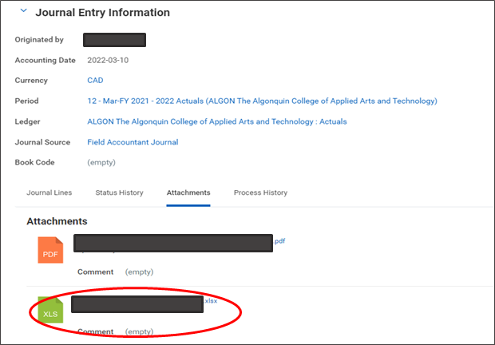
Show All Calculations Example: The attached Excel file includes relevant calculations

Slide 6
Provide reference & backup to show the source of dollar amounts
Provide documentation showing the original amounts used in all calculations (include report screenshots)
Remember to highlight and/or circle the relevant transaction(s) and please reference page number(s) where these can be found
Revenue/Expenses are not recognized until they are recorded in the General Ledger. When transferring expenses, GL references are the only valid backup
Example: specific EXPJ-##########, SINJ-##########, etc., or a printout of the FIN RPT - Financial Rollup Report, or bank statements showing transaction

Slide 7
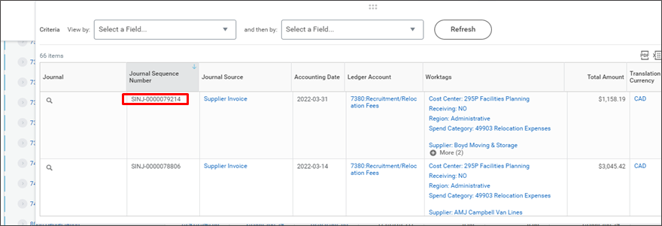
Provide reference and backup to show the source of dollar amounts Example: Journal Sequence Number information is highlighted

Slide 8
Include summary sheet for complex spreadsheets
If the calculations in an Excel spreadsheet involve multiple tabs or are complex, add a Summary Sheet tab that cell-references other sheets and summarizes the values of the Journal Entry
Include annotations that explain what is being referenced and how it is relevant to the journal
Remember that all calculation details must be included and a summary alone is not adequate

Slide 9
Include a journal entry summary tab in complex spreadsheets Example: Summary Sheet is the tab that ties the detail sheets to the journal entry dollar values
1
1
3
2
Summary Sheet and cell-references
Annotation
Detailed calculation sheets

Slide 10
Redact/remove and/or do not submit confidential information
Personal or confidential information cannot be included
Redact confidential information including but not limited to:
Investment account and bank account transit numbers
Credit card numbers
Employee names
Birthdays
Addresses
Payroll reports
Student names and other student information, marks, etc.
Other confidential information

Slide 11
Cont. - Redact/remove and/or do not submit confidential information
Confidential information backup can be retained by the originating department and made available to Finance and auditors upon request
To ensure compliance see Policy IT01 and the Algonquin College Privacy Statement: https://www.algonquincollege.com/policies/files/2021/01/IT01.pdf https://www.algonquincollege.com/policies/privacy/
NOTE: Confidential information backup files must be retained by the originating department for current year+7 years

Slide 12
Include relevant email trails showing approvals
Where relevant to the journal entry, ensure all prior approvals are in place and included in the journal entry backup. E.g., email showing approval
The “Forward” response should be used by the approving manager for email backups so the files that have been reviewed are included in the approval email Do not submit a “Reply” response because the reviewed and approved files will not be included and therefore the approval cannot be assumed to be for the dollar amounts in the journal entry

Slide 13
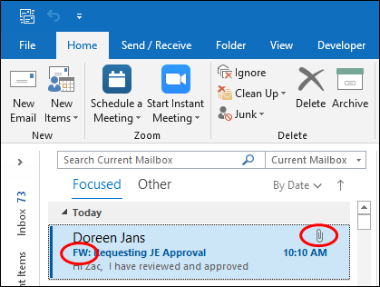
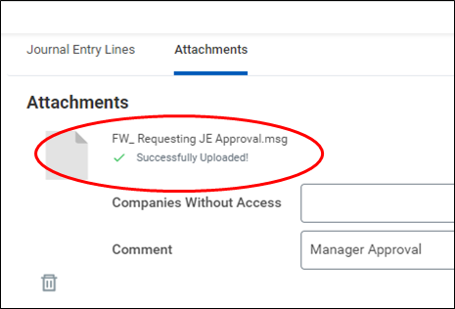
Include relevant email trails showing approvals Example: Attach “forwarded” email approval. This is an upload of the Outlook email a Workday Journal attachment. Do use printed or copied text from an email.
Outlook
Workday

Slide 14
Only include relevant portion of supporting documents
When a journal entry relies on information from a large data file (such as a contract or multi-page report), include a screenshot of the journal-relevant backup rather than the large data file
Ensure backup documents are legible (not blurry, readable font size, etc.)
Large data file must be made available to Finance and auditors upon request, for up to current year+7 years.
Where a report of financial data is the subledger data, the complete file is needed
Example: if only the budget is relevant to the Journal, only include screenshots of the budget pages, labeling the excerpt to reference the large data file.

Slide 15
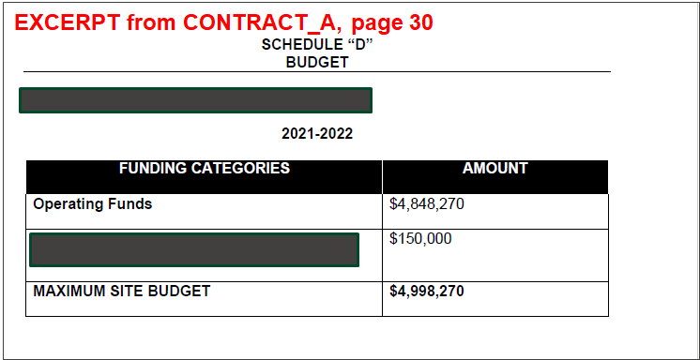
Only include relevant portion of supporting documents Example: Include a screenshot of the information related to the journal, not the full document

Slide 16
Questions?
FinServices@algonquincollege.com

