Slide 1
Cost Center Manager Training – How to Review a Journal Entry
Provided by Financial Services
March 19, 2025

Slide 2
Agenda
1. Why?
2. Why Now?
3. The Details
4. Courtesy/Etiquette
5. The Demo
6. Q & A Time
7. Resource Materials and Links

Slide 3
Why?
Manual Journal entries are posted in the General Ledger
The General Ledger is the basis of the College’s external Financial Statements.
The Financial Statements and all transactional details of the General Ledger and its feeder ledgers (subledgers) undergo the rigor of an external audit.
Journal entries are manual, increasing the risk of human error.
No one is perfect.
Reviewer/approvers are a key element of the checks and balances.
Notes:
Add this slide to cc manager training

Slide 4
Why Now? Journal Entry Approval Workflow
Journal Source: Field Accountant Journal
Field Accountant Create Journal
Cost Center Manager
Review and Final Approval if <$2,500
Accountant CCH Approver (Finance)
Review and final approval if >$2,500 but <$100K
Controller
Review and Approval
>$100K
VP Finance
Final Review, Approval and Posting > $100K
Approval by
April 10 at
5pm
Journal Source: Accrual Journal
Financial Services Supervisor
(Finance)
Review if >$25K
Accounting Manager (Finance)
Review and Final Approval if >$25K but <$100k
Field Accountant Create Journal
Cost Center Manager
Review and Final Approval if <$25K
Accountant CCH Approver (Finance) Review if >$25K
Controller
Review and Approval
>$100K
VP Finance
Final Review, Approval and Posting > $100K

Slide 5
The Details Algonquin College Years
Year Name | Start Date | End Date | Examples
Academic | September 1 | August 31 | Course planning
Calendar | January 1 | December 31 | Salary taxes
Fiscal | April 1 | March 31 | External financial statement reporting
Notes:
Add this slide to cc manager training

Slide 6
The Details Year-End Journal Entries – what makes them different?
Accrual and deferral entries will reverse the following fiscal year on April 1
Journal values must be >$5,000 unless contract-related
Pre-paid invoices > $10,000 for 12 months, must be set up as Pre-Paid assets
Submitted directly in Workday using “Accrual” journal source
Approvals in Workday workflow

Slide 7
The Details Accrual Accounting
Basic Definition: Accrual accounting is an accounting method where revenues and expenses are recorded when earned or incurred, not when cash is exchanged.
Workday Transactions:
Transactions are recorded in the General Ledger on a cash accounting basis.
Notes:
Add this slide to cc manager training

Slide 8
The Details Income Statement Transactions
Decreases Revenue
Increases Revenue
DEBIT
CREDIT
Increases Expenses
Decreases Expenses

Slide 9
The Details Balance Sheet Transactions
Increases Assets
Decreases Assets
DEBIT
CREDIT
Decreases Liabilities
Increases Liabilities

Slide 10
The Details Accrual Entry Definitions
Expense Accrual (Accrued Liabilities): Accrued liabilities are expenses that the College has incurred but has not yet paid or recorded.
Example: Contracted teaching service received during March, but the invoice has yet to be issued by the consultant/supplier. Must accrue the March expense.
Revenue Deferral: Unearned revenue or deferred income, represents money a company receives for goods or services that haven't been delivered or performed yet.
Example: The Ministry has provided funding for a contract from Sept. 1 until Aug. 31. Must defer the revenue related to April – Aug.

Slide 11
The Details Accrual Entry Definitions
Prepaid Expenses: Prepaid expenses are payments made in advance for goods or services to be received in the future.
Example: An annual software license is purchased in January for the period Jan. 1 to Dec. 31. The prorated value from April 1 to December 31 must be removed as an expense and established as a Pre-Paid asset.
Revenue Receivable: A receivable is created any time money is owed to for a service provided that has not yet been invoiced.
Example: The College offered Corporate Training in March but has not yet invoiced the client.

Slide 12
The Details Summary Table – Ledger Account and Worktags for Year End Accrual Entries
Journal Entry Category | Entry Debit and Credit | Worktag (if needed) | Line Item text | Appropriate Backup
Expense Accrual | Dr. Expense (Cost Centre and Spend Category) Cr. Accrued Liabilities – ledger account 2080 | No Worktag Needed | “To accrue 2024-25 expense for…” | Invoice copy Confirmation that good / service was received in fiscal year but not yet recorded in ledger Amount of invoice clearly indicated including portion of non-refundable HST at 3.41%
Revenue Deferral | Dr. Revenue (Cost Centre and Revenue Category) Cr. Deferred Revenue – ledger account 2500 | Deferred Revenue – Other Deferred Rev – MTCU Contracts Deferred Revenue - Contracts | “To defer revenue to next fiscal year for…” | CR – Financial Rollup report showing revenue booked and amount to be deferred Excerpt of agreement indicating amount may be deferred (ie. Contract period extending into next fiscal year, Ministry approval etc.)
Prepaid Expense | Dr. Prepaid Expenses Operating – ledger account 1500 Cr. Expense (Cost Centre and Spend Category) | No Worktag Needed | “To set up 2024-25 prepaid expense for…” | Same invoice details as listed above for expense accruals with indication of period of time covered GL detail of amount in expense Details of the calculation of the prepaid amount
Revenue Receivable | Dr. A/R MTCU – ledger account 1230 or Other AR – ledger account 1370 Cr. Revenue (Cost Centre and Revenue Category) | No Worktag Needed | “To set up 2024-25 receivable for revenue earned for…” | Excerpt of agreement indicating amount of funding to be received in current fiscal year CR – Financial Rollup report showing total expenses incurred

Slide 13
The Details Journal Entry Backup
Show all calculations.
Provide reference & backup to show the source of dollar amounts.
Include a journal entry summary tab in complex spreadsheets.
Redact/remove and/or do not submit confidential information.
Include relevant email trails showing approvals.
Only include relevant portion of supporting documents.
Examples of backup include invoice copies, general ledger printouts, Workday cost center reports, excerpt of contract etc.
JE Backup Checklist

Slide 14
The Details Fiscal Reporting Timeline for 2024-25
Start of the Fiscal Period
April 1, 2024
F
I
N
A
N
C
I
A
L
ST
ATEMENTS
End of the Fiscal Period
March 31, 2025
April 10, 2025
Jan. 1, 2025
Additional Time for accounting
Fiscal Reporting Year
CC Manager Approved Journal Entry Cut-off
Notes:
Add this slide to cc manager training

Slide 15
Courtesy/Etiquette
Workday transactions affecting more than one (1) cost centre, including journal entries:
The transaction is populated in each cost centre manager’s Workday Inbox for review/approval
When a cost centre manager approves the transaction, the transaction is REMOVED from the other cost centre manger’s Workday Inbox
The journal entry is archived in the approver’s Archive folder; it is simply removed and never archived in the other impacted cost centre manager(s)’ Archive folder.
However, the transaction is completed in the Workday General Ledger

Slide 16
Courtesy/Etiquette
The 1st cc manger to see an entry should not necessarily ‘Approve’ it!
As a courtesy:
If a journal is DECREASING (debit) revenue, allow the cc manager with the decreased revenue to approve the journal entry.
If a journal is INCREASING (debit) expenses, allow the cc manager who will see their expenses increase approve the journal entry.

Slide 17
Courtesy/Etiquette For Income Statement Transactions
Decreases Revenue
Increases Revenue
DEBIT
CREDIT
Increases Expenses
Decreases Expenses
The courtesy:
The cc manager impacted by the debit transactions on a journal entry should APPROVE the journal entry in Workday.

Slide 18
The DEMO
Workday Inbox Approvals

Slide 19
Reference materials found at the end of the presentation:
Workday Definitions
Sample of the FDM (Chart of Accounts)
Workday Inbox – Regular Journal Entry
Workday Inbox – Accrual Journal Entry
Finance and Administrative Services Dashboard

Slide 20
Q & A Time
FinServices@algonquincollege.com

Slide 21
Thank you.

Slide 22
Resource Materials and Links

Slide 23
Term | Identifiable Reference # | Definition
Financial Data Model (FDM) |  | The College's Chart of Accounts. A complete listing of revenue and spend categories with associated ledger accounts. Found here: FDM Mapping including description
Ledger Account |  | A balance sheet account alone, or the sum of multiple revenue or spend categories.
Revenue Category | Starting with ‘3’. i.e. 39908 Miscellaneous Revenue | A revenue account – utilize the Revenue Category in the FDM that most accurately reflects the transaction being recorded.
Spend Category | Starting with ‘4’. i.e. 44200 Office Supplies | An expense account - utilize the Spend Category in the FDM that most accurately reflects the transaction being recorded.
Cost Center | 3 digits and a letter. i.e. 284F Financial Services Manager | A department or other unit within an organization to which revenue and expenses may be assigned for accounting purposes. Revenues and expenses transactions must include a cost centre.
Journal Source |  | Indicates the purpose of the transaction (e.g. Online Journal, Expense Report, etc.)
Additional Worktags |  | Some transactions require an additional worktag such as a gift, net asset detail or deferred revenue. The FDM Mapping file identifies categories that require additional worktags.

Slide 24
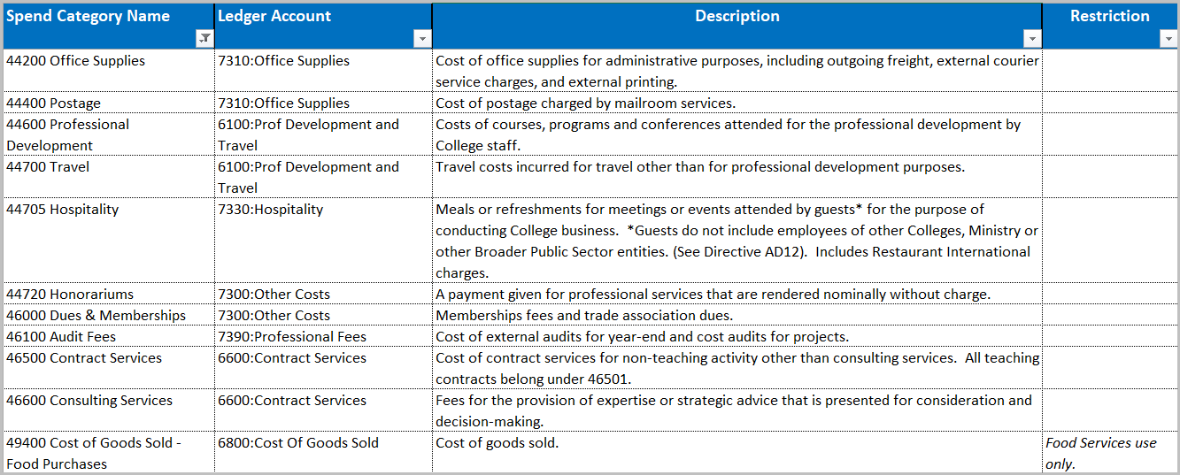
Excerpt of Financial Data Model (FDM)
Financial Data Model (FDM)

Slide 25
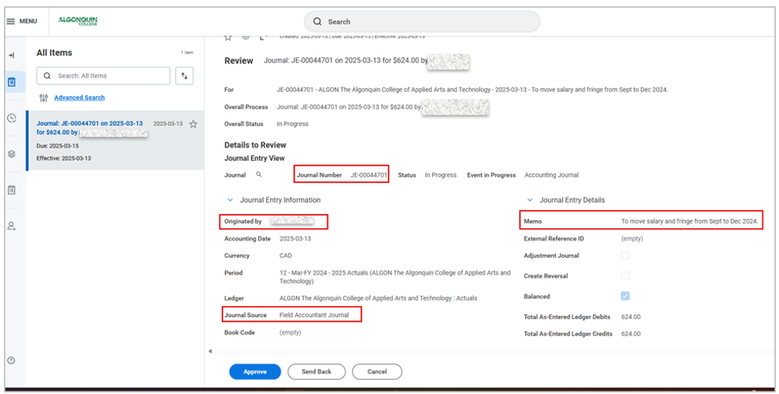
Workday Inbox – Regular Journal Entry cont’d

Slide 26
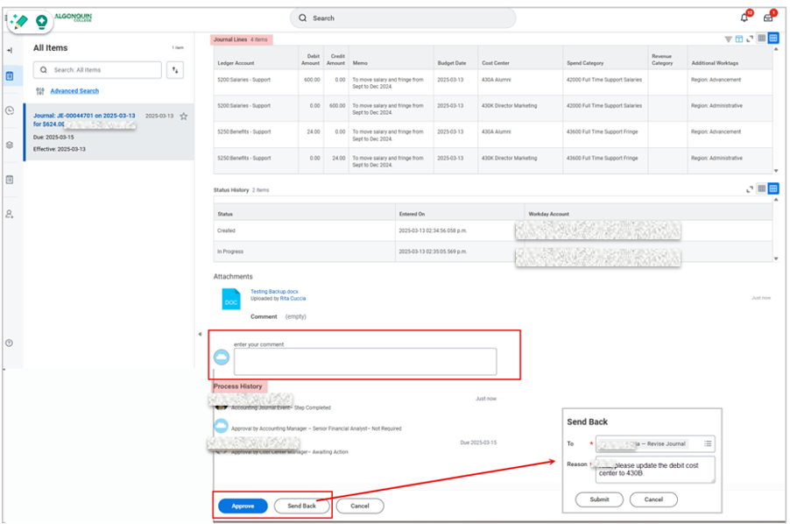
Workday Inbox – Regular Journal Entry cont’d

Slide 27
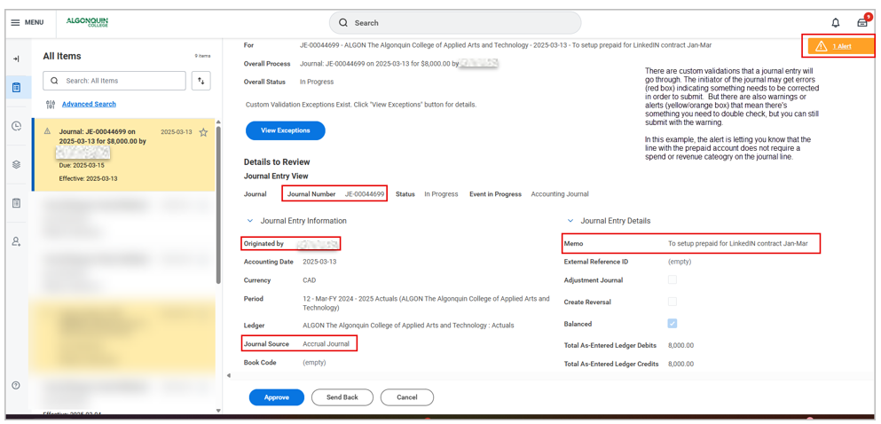
Workday Inbox – Accrual Journal Entry

Slide 28
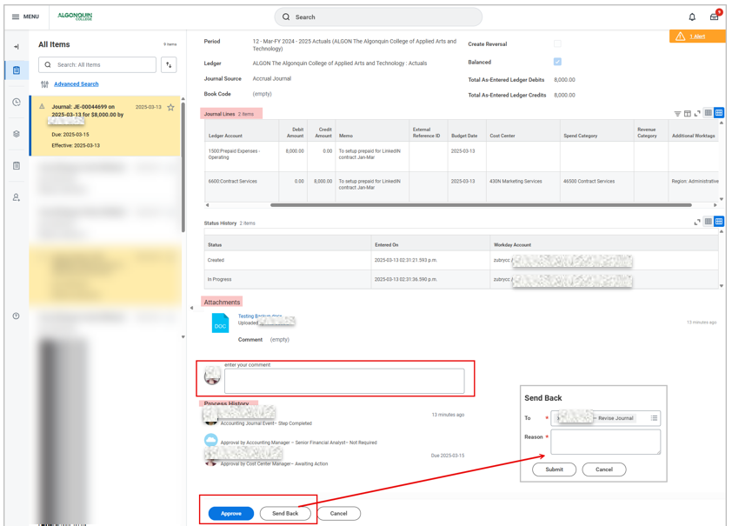
Workday Inbox – Accrual Journal Entry cont’d

Slide 29
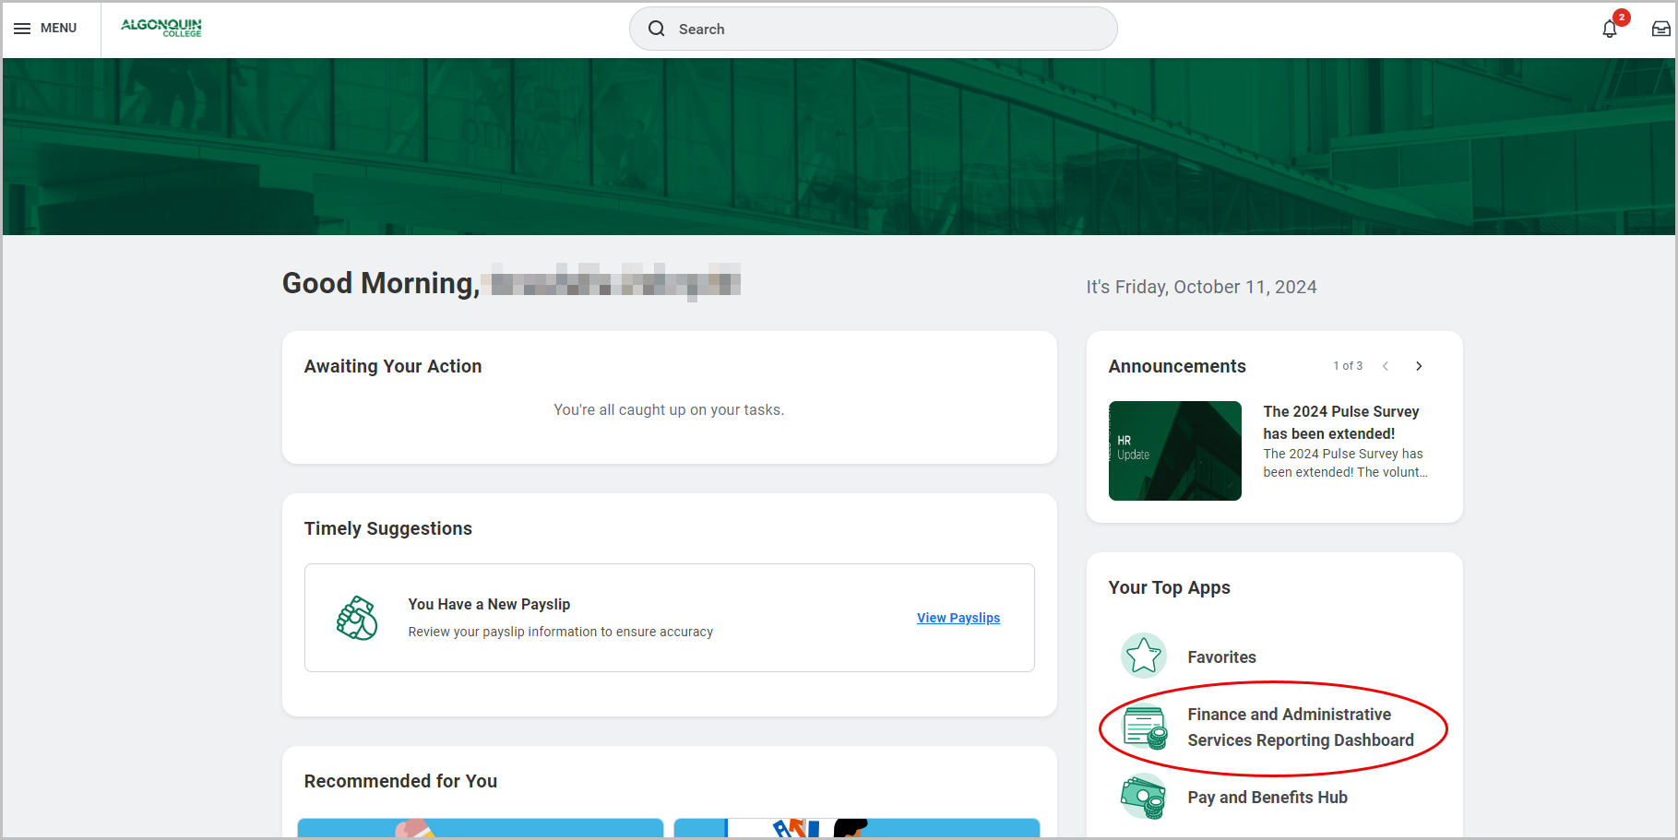
Finance and Administrative Services Reporting Dashboard
For your reporting convenience:
Notes:
Add this slide to cc manager training

Slide 30
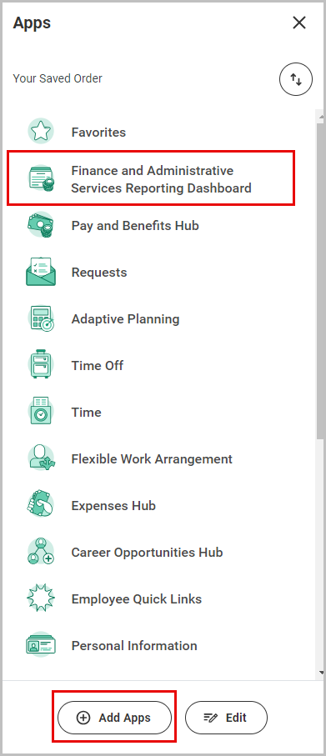
Adding Finance and Administrative Services Reporting Dashboard to App
If the dashboard app does not appear under your top apps on the home page, click on the Menu button on the top left of your home screen in Workday to access the dashboard.
If the app does not appear in your list, click on the Add Apps button at the bottom of the menu.
Search for the app and add it to your list.

Slide 31
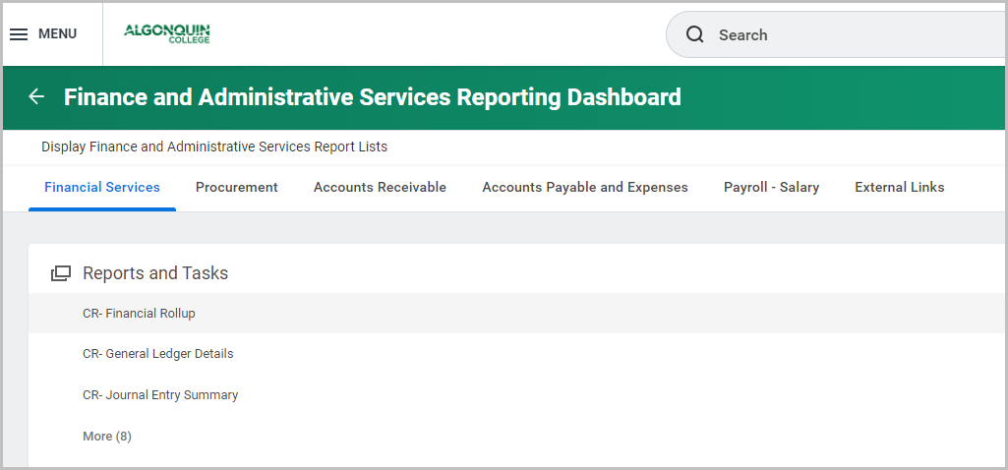
Reports Based on Security Roles & Cost Center Access

