Slide 1
Workday Training for Year-End Journal Entry Accruals
March 5, 2025

Slide 2
Agenda
1. Overview of Year End Journal Entries
2. Process for Submission of Year End Journal Entries in
Workday
3. JE Backup and Approval Process in Workday
4. Demo
5. Find Journals
6. Review Checklist
7. Resources

Slide 3
Year End Journal Entries – what makes them different?
Accrual and deferral entries that will reverse out the following month
Must be >$5,000 unless contract related
Submitted directly in Workday using “Accrual” journal source
Approvals in Workday

Slide 4
Summary Table – Ledger Account and Worktags for Year End Accrual Entries
Journal Entry Category | Entry Debit and Credit | Worktag (if needed) | Line Item text | Appropriate Backup
Expense Accrual | Dr. Expense (Cost Centre and Spend Category) Cr. Accrued Liabilities – ledger account 2080 | No Worktag Needed | “To accrue 2024-25 expense for…” | Invoice copy Confirmation that good / service was received in fiscal year but not yet recorded in ledger Amount of invoice clearly indicated including portion of non-refundable HST at 3.41%
Revenue Deferral | Dr. Revenue (Cost Centre and Revenue Category) Cr. Deferred Revenue – ledger account 2500 | Deferred Revenue – Other Deferred Rev – MTCU Contracts Deferred Revenue - Contracts | “To defer revenue to next fiscal year for…” | CR – Financial Rollup report showing revenue booked and amount to be deferred Excerpt of agreement indicating amount may be deferred (ie. Contract period extending into next fiscal year, Ministry approval etc.)
Prepaid Expense | Dr. Prepaid Expenses Operating – ledger account 1500 Cr. Expense (Cost Centre and Spend Category) | No Worktag Needed | “To set up 2024-25 prepaid expense for…” | Same invoice details as listed above for expense accruals with indication of period of time covered GL detail of amount in expense Details of the calculation of the prepaid amount
Revenue Receivable | Dr. A/R MTCU – ledger account 1230 or Other AR – ledger account 1370 Cr. Revenue (Cost Centre and Revenue Category) | No Worktag Needed | “To set up 2024-25 receivable for revenue earned for…” | Excerpt of agreement indicating amount of funding to be received in current fiscal year CR – Financial Rollup report showing total expenses incurred

Slide 5
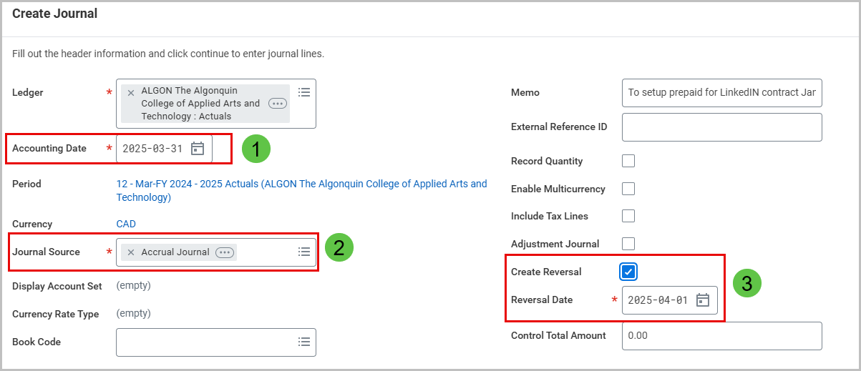
Submission Process for Year End Reversing Accrual Journal Entries
The journal entry will be entered and submitted directly in Workday where it will follow the approval process
1. Accounting Date = March 31 2025
2. Select Accrual Journal source
3. Click on Create Reversal

Slide 6
Checklist for Journal Entry Backup
1. Show all calculations
2. Provide reference & backup to show the source of dollar amounts
3. Include a journal entry summary tab in complex spreadsheets
4. Redact/remove and/or do not submit confidential information
5. Include relevant email trails showing approvals
6. Only include relevant portion of supporting documents

Slide 7
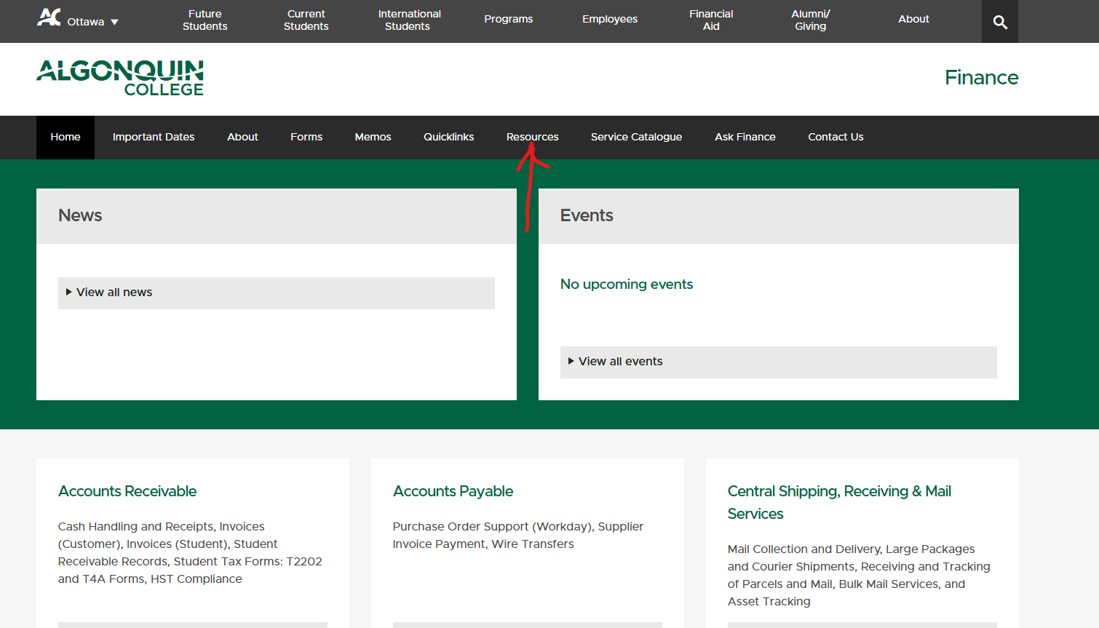
More Details on Journal Entry Backup
Journal Entry Backup Checklist

Slide 8
Approval Process in Workday
Financial Services Supervisor
(Finance)
Review if >$25K
Accounting Manager (Finance)
Review and Final Approval if >$25K but <$100k
Field Accountant Create Journal
Cost Center Manager
Review and Final Approval if <$25K
Accountant CCH Approver (Finance) Review if >$25K
Controller
Review and Approval
>$100K
VP Finance
Final Review, Approval and Posting > $100K

Slide 9
DEMO

Slide 10
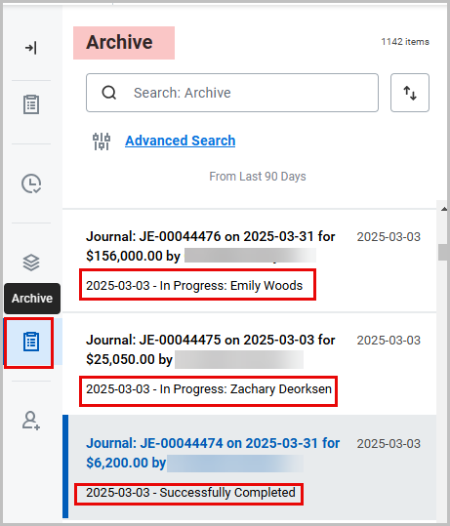
How to Find your Journal Entries
Workday Inbox Archive

Slide 11
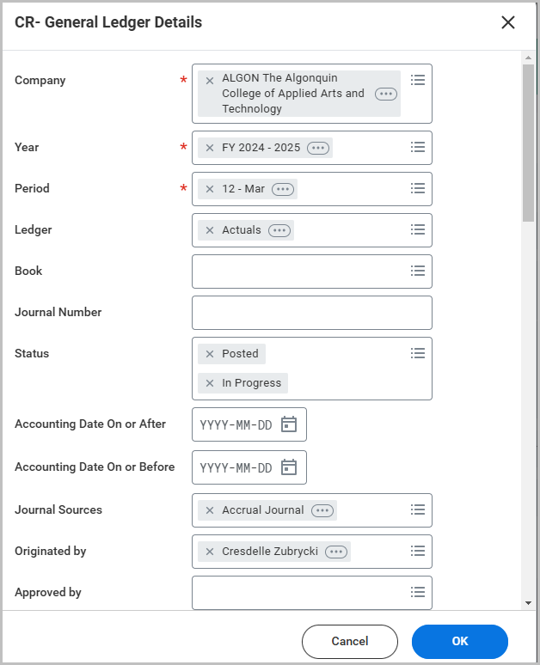
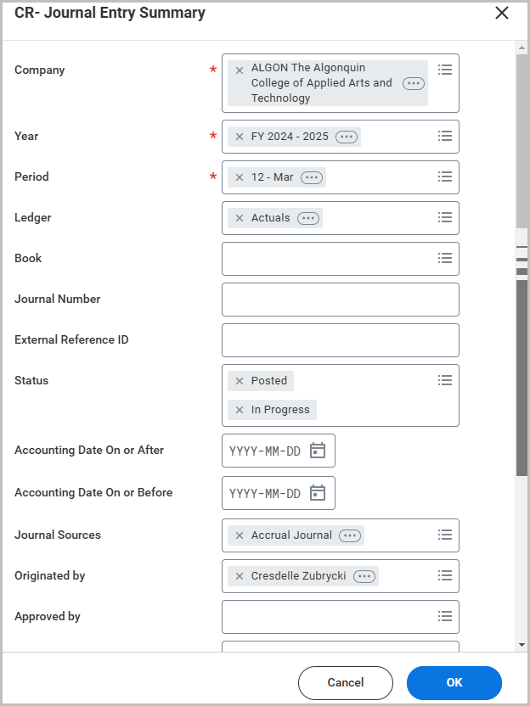
How to Find your Journal Entries
CR- General Ledger Details or CR- Journal Entry Summary

Slide 12
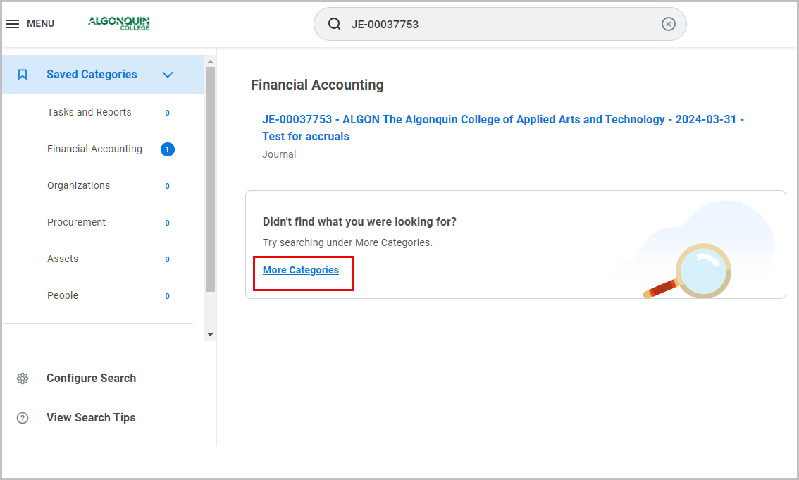
How to Find your Journal Entries
Search box in Workday if you have the journal number

Slide 13
Review Checklist
Accounting Date = “2025-03-31”
Journal Source = “Accrual Journal”
Create Reversal =
Reversal Date = “2025-04-01”
Line Memo is required (copy & paste the Header Memo) on the line of the journal with the balance sheet account
No Cost Center, Revenue or Spend Category, or Region required on the Balance Sheet Line
Deferred Revenue Worktag if required
Check your Workday inbox daily in case a journal is sent back

Slide 14
Resources
Journal Entry Backup Checklist
Journal Entry Backup Checklist.pdf
Journal Entry – Workday User Guide
Create a Journal Entry - Field Accountant.pdf
Link to Year End Schedules and Deadlines:
2024-2025 Year-End Processing and Purchasing Due Dates
2024-2025 Year End Schedule for Business Administrators, Finance Managers and Controllers

Slide 15
Thank you.

