Slide 1
Predictions: Your Network Security in 2018
Greg Young
Twitter: @orangeklaxon
Research Vice President and
Global Lead Analyst, Network Security
Notes:
Predictions: Your Network Security in 2018
Security & Risk Management Summit
June 10-13, 2013
Gaylord National
National Harbor, MD
Greg Young
This presentation, including any supporting materials, is owned by Gartner, Inc. and/or its affiliates and is for the sole use of the intended Gartner audience or other authorized recipients. This presentation may contain information that is confidential, proprietary or otherwise legally protected, and it may not be further copied, distributed or publicly displayed without the express written permission of Gartner, Inc. or its affiliates.
© 2013 Gartner, Inc. and/or its affiliates. All rights reserved.
Notes accompany this presentation. Please select Notes Page view.
These materials can be reproduced only with written approval from Gartner.
Such approvals must be requested via email: vendor.relations@gartner.com.
Gartner is a registered trademark of Gartner, Inc. or its affiliates.

Slide 2
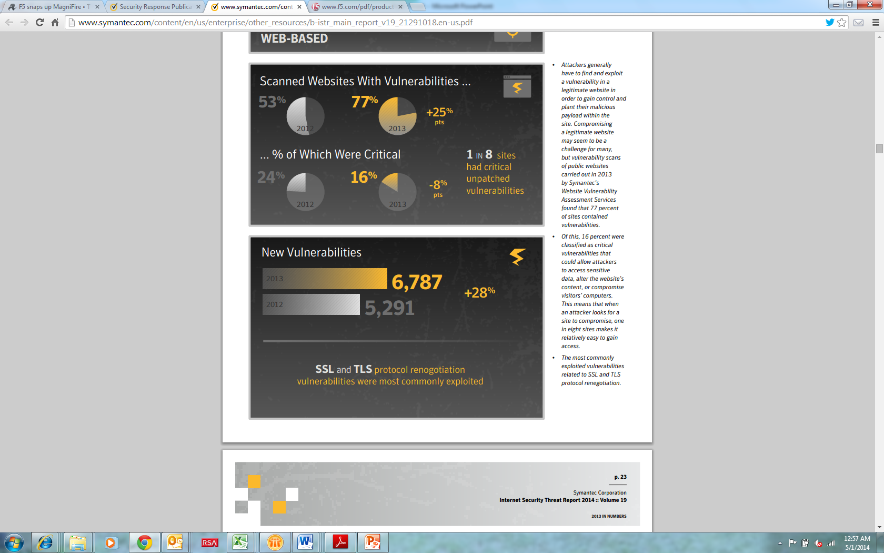
We’re Getting More Vulnerable
Source: Symantec Internet Security Threat Report 2014

Slide 3
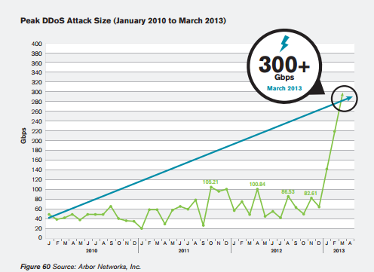
Attacks Are Hurting More

Slide 4
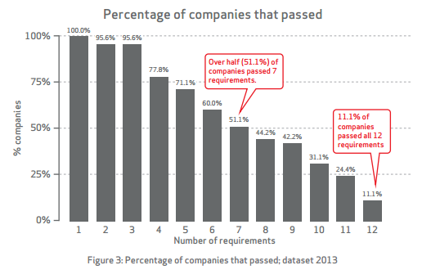
Compliance is not Good Enough, but We can’t Even Get It
Source: Verizon 2014 PCI Compliance Report

Slide 5
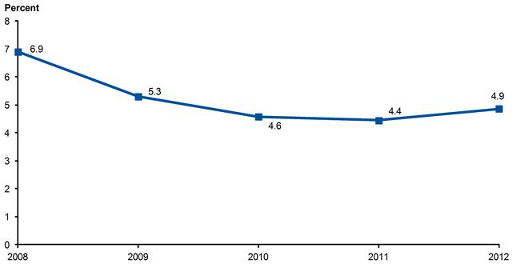
We Have Fewer Of Our Staff Securing Us
IT Security Support Full-Time Equivalents
as a Percentage of Total IT Full-Time Equivalent
From 2008 to 2012

Slide 6
Security Spend Continues To Take Larger Share of IT Pie
Cumulative %
Year
Source: Only required for non-Gartner research
Notes:
Placeholder for text (substitute your own text; delete when not used)

Slide 7
Security Spending by Segment 2014

Slide 8
Security Spending by Segment 2014

Slide 9
Market Subdivision: Tech. Maturity
expectations
Application Shielding
Dynamic Data Masking
Interoperable Storage Encryption
Hypervisor Security Protection
IaaS Container Encryption
Stateful Firewalls
Security in the Switch
Secure Email Gateway
Advanced Threat Detection Appliances
Network IPS
Operational Technology Security
Dynamic Application
Security Testing
Penetration Testing Tools
Cloud-Based Security Services
Vulnerability Assessment
Introspection
WLAN IPS
Context-Aware Security
Web Services Security Gateway
Open-Source Security Tools
Mobile Data Protection
Software Composition
Analysis
SIEM
DDoS Defense
Web Application Firewalls
Secure Web
Gateways
Next-Generation Firewalls
Network Security Silicon
DMZ Virtualization
Static Data Masking
Endpoint Protection Platform
Static Application Security Testing
Next-Generation IPS
Network Access Control
Application Control
Unified Threat Management (UTM)
As of July 2013
Database Audit and Protection
Innovation Trigger
Peak of
Inflated Expectations
Trough of Disillusionment
Plateau of Productivity
Slope of Enlightenment
time
Plateau will be reached in:
obsolete
before plateau
less than 2 years
2 to 5 years
5 to 10 years
more than 10 years
From: "Hype Cycle for Infrastructure Protection, 2013," 31 July 2013 (G00251969)

Slide 10

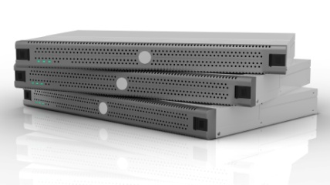
No, Sorry — Still No Massive Netsec Convergence in 2018
In 2018, most of you will still have a stand-alone
next-generation firewall (NGFW), secure Web gateway (SWG)
and other stuff
NGFW
ATA
EPP
SWG
Notes:
Enterprises spend about 5% of their IT budgets on security, which works out to at about 0.3% to 0.4% of their overall revenue. This adds up to billions of dollars per year — yet attacks still succeed?
Well, the oldest form of business is commerce. From the earliest times to the days of e-commerce, shrinkage (employee theft + shoplifting) has averaged 1.5% of revenue, and retail has spent 1.5% of revenue to keep shrinkage at that level. This means that 3% of revenue (almost 10 times the spending on information security) is spent on fighting shrinkage — and yet it still occurs.
Crime and security incidents never go away — success means limiting them to an acceptable cost of doing business.

Slide 11
Some of Your Netsec Moves Into the Cloud
Off-premises SWG is growing fastest: 13% cloud today, with predictions of 25% by 2015; but it's slow moving and likely to still be 25% in 2018.
ATA will continue to have cloud assistance.
Firewall and IPS remain on-premises.
Hosting remains the exception where all can be in the cloud.

Slide 12
Some of Your Netsec Does Converge
ATA coordination capability moving into SWG and NGFW.
SSL VPN moves mostly into firewall.
URL filtering, already converged, can go in a
few places.
NGFW expansion continues; ATA incorporates traditional IPS.
Stand-alone IPS becomes rarer.
Firewalls optimized for data center produced by mainstream firewall vendors: one-brand bias continues.

Slide 13
Security Intelligence
Security Intelligence will remain undefined in 2018
In other words…
Security will not be that intelligent in 2018
SIEM platform maintains its role as primary information and event correlation point. Wide, yet shallow, and will not be a console replacement.
SIEM will expand its capabilities and handle more events, rather than point products for "security intelligence" being deployed.
Consoles will remain the best primary source, yet remain silos — what analysts use after SIEM.

Slide 14
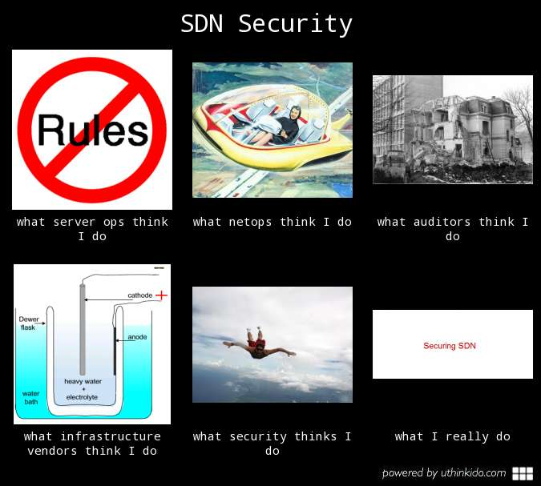
Notes:
Does SDN security mean different things depending on whom you ask?

Slide 15
SDN Security in 2018 Will Be Either …
SDN Security
Securing SDN
or
A standard,
multivendor protection
Infrastructure provided
Self-defending controller
Security interoperability
Protecting controllers
Third-party vendors
Logically, the same
as we do today
Change control doesn't … change
Compliance doesn't change
So which of the two is it?

Slide 16

We’ve Seen Shifts Before
Viruses
Spam
Worms
Not solved, but reduced to mostly minor annoyance levels
Always followed by spending changes
Or Shifted To New, More Difficult Paths

Slide 17
Reduced Impact
Source: Symantec Internet Security Threat Report 2014

Slide 18
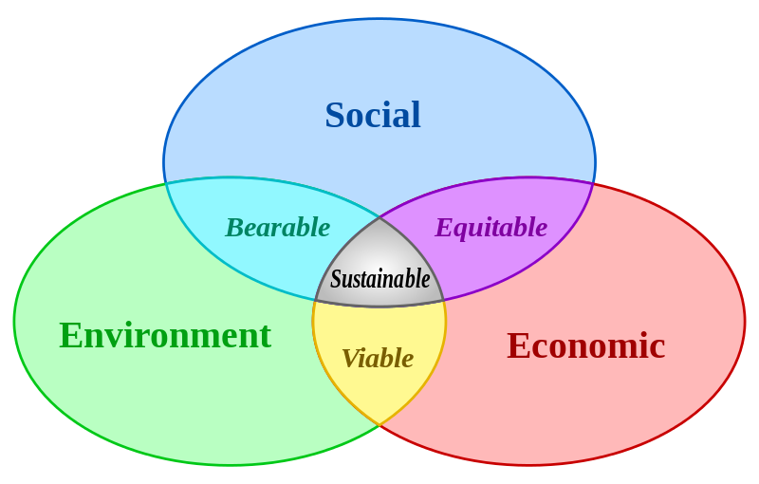
Security Sustainability
Source: Wikipedia, Sustainability

Slide 19
Impediments to Sustaining the Current Trajectory
Spying
Open Source
Alerts
SMB
Staffing
Spending
Partial Source: Wikipedia, Sustainability

Slide 20
In 2018 Your Netsec Will….
Be expensive and mostly point solutions.
Use out-of-band inspection — still mainstream for WAN/LAN and very-high-speed links.
Need to secure your SDN and virtualization, as they won't be self-defending.
Require accommodation of mixed IPv4/v6.
Have more hybrid aspects.
Still be deployed in depth.
Not be fully virtualized, but accommodate virtualization.
Call to Action: 2018 is less than one firewall refresh away.

Slide 21

Likely 2018 Crisis Points
Common criteria devalued without replacement.
Advancing rate of security product vulnerabilities and poor disclosure.
Security of IPv6 within products lags behind IPv6 adoption rates.
No let up in threat will stress netsec budgets and operations.

Slide 22
Secure Network Design Principles
No single element compromise should compromise the whole application stream.
Put trust in trusted components.
Isolation to isolate. Segmentation to segment.
Hosts are not self-defending.
Correlation, visibility, least privilege, and compliance.
By jove, these principles stand the
test of time and are
not some faddish feature.
Like my wig. Or my pen.
The frilly shirt still rocks, yes?

Slide 23
Recommended Gartner Research
Ending the Confusion About Software-Defined Networking: A Taxonomy
Joe Skorupa and others (G00248592)
Magic Quadrant for Enterprise Network Firewalls
Greg Young (G00229302)
Hype Cycle for Infrastructure Protection
Greg Young (G00229303)
For more information, stop by Gartner Research Zone.

Slide 24
Additional Material

Slide 25
The Controller Needs Protecting
But they promised
I’d be self-defending
Controller
Vulnerabilities
Spoofing switches
Controller
Resource
consumption
DDoS

Slide 26
So, Protect The Controller
New
Safeguards
Default SSL
On
IPS
Controller
Vulnerabilities
Hardened
Authentication
Spoofing switches
Controller
IDS
Specific QoS
Redundant
Paths
Resource
consumption
DDOS

Slide 27

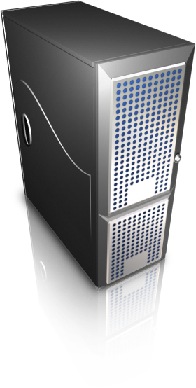

Look To Your Current Security Vendors… But Most Are Not There Yet
Better integration of 3rd party security ecosystem
It is still the early days
Limited firewall rule self-provisioning
Security control plane integration into orchestration for context sharing
Better isolation of security control plane
Infrastructure vendor sales force has trouble letting go
SPA: Through 2018, more than 75% of enterprises will continue to seek network security from a different vendor than their network infrastructure vendor.
Get your polygraph warmed up – most security vendors are not on top of SDN/NFV

Slide 28
What Does IPv6 and DOS Mean to Security in 2018?

Slide 29
Volumetric Defenses Go More Hybrid
2006
"The attacks are bigger than my pipes"
2010
"Cloud-only is too much $"
2014
"These need to work together better"
2018
Off-Premises
CPE

Slide 30
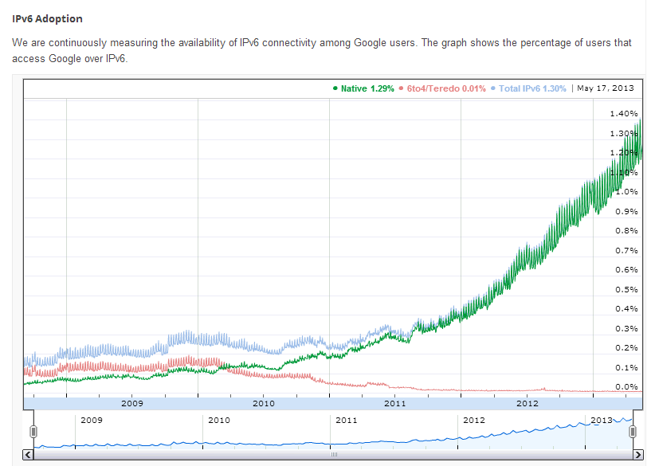
IPv6 Security Needs IPv6
Source: Google
Notes:
Historically, demand for IPv4 addresses has been for about 200 million per year. By the end of 2014, reduced supply and increasing demand for IPv4 will result in a shortfall of nearly 1 billion addresses.
It's taken the U.S. two years of geometric growth for IPv6 to represent 2.5% of overall Internet traffic. At that rate, it will take 80 years for IPv6 traffic levels to reach 100%.
Just over 1% of users have accessed Google over IPv6. Romania has nearly 10% of its population using IPv6. Average usage of IPv6 across the Internet is at 1.2%. Only 10 of the world's 200 or so countries contribute to that average. Half the world's transit ISPs support IPv6. Half the hosts connected to the Internet have support for IPv6.
On the other hand, over half (56%) of the ISPs in North America do not support IPv6.
Source: Infoblox

Slide 31
Commonly Seen Characteristics of Security Threats that are Peaking
Lowered impact of attacks notwithstanding lowered or increased occurrences.
Enterprise response has become ‘operationalized’, and is now handled by an established safeguard with little staff interaction, workflow, helpdesk, or vulnerability management procedure.
The acquisition or disappearance of the majority of pure-play products specific to the threat.
The threat is being subsumed into a newer or more advanced threat.
Point products are converging into existing security products as a feature— especially when offered at no additional charge.

Slide 32
Buy Hedges (And Maybe Save Anyway)
Lease
Commitment
MSSP
Off Prem
Cloud
As-A-Service

Slide 33
Breaking A Link In the Kill Chain
Reconnaissance
Weaponization
Delivery
Exploitation
Installation
Command&Control
Actions On Objectives
Getting good at one can hinder across multi-vectors
Reduced Gray Lists
Behavioral
ATA
Anti-evasion
Pre-filters
SSL-inspection
Cloud lists

