Slide 1
A TEST OF OUR FORESIGHT: POSSIBLE FUTURES FOR HIGHER EDUCATION
Stephen Murgatroyd, PhD
Chief Innovation Officer
Contact North | Contact Nord

Slide 2
Who Am I
Teaching at the university level since 1973
Psychologist by training but have taught in both statistics programs and in business schools
Now act as Chief Innovation Officer for Contact North | Contact Nord
Now working on strategic foresight as a teacher at the University of Toronto (OISE) and University of Alberta and Athabasca University (MBA)
Created the world’s first fully online MBA in 1993-4 and have been building and working with technology enabled learning experiences ever since
Worked for 15 years at the Open University (UK) and for 14 years at Athabasca University
Consultant, writer and imagineer

Slide 3
This Presentation
Outline some futures scenarios based on the work of Benjamin Bratton
Three features of our historical landscape that impact our future
Five dynamics in the current environment that we should pay attention to – they will shape our future
Four focal points for you to consider – action points

Slide 4
Four Scenarios for the Future (Based on the work of Benjamin Bratton)

Slide 5
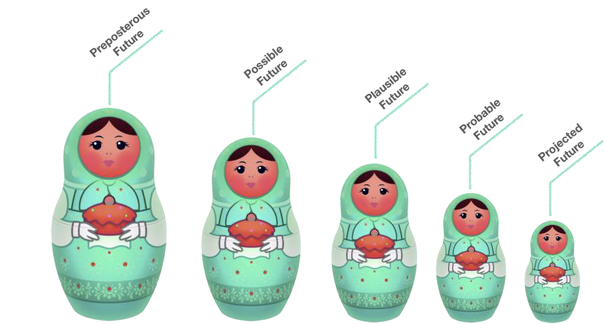
The Futures of the PSE System

Slide 6
Four Futures in a (Post-Pandemic?) World –
An Epidemiological View
Sensing High
Wanting to Know - Engaging Difference and Complexity
1
2
3
4
The Atomistic Transactional Self
“What’s in it for me?”
The Interconnected Self
“It’s about all of us critters in ecologies of communities”
Sensing Low
Not Knowing, Not Wanting to Know – Indifference to Complexity
Adapted from Bratton, B. (2020). 18 Lessons of Quarantine Urbanism. Strelka Mag.
https://strelkamag.com/en/article/18-lessons-from-quarantine-urbanism
Notes:
Two trajectories on two axes that generate four scenarios.

Slide 7
3 Long Standing Patterns

Slide 8
1: Tension Over Purpose
What is the purpose of the university?
Search for truth, meaning and understanding or vocational preparation and social change (Richard Hofsteader, 1968)?
Public good and active citizenship or commercialization and commodification?
What is the difference between a University, a College and a Polytechnic?
Development of highly qualified people and research aimed at innovative economic growth versus skills and applied research?
STEM versus Arts, Humanities and Social Sciences
Preoccupation with STEM is a distraction from what society needs
50% of those who work in STEM do not have STEM qualifications – design, arts, social science are just as important for STEM

Slide 9
2: Tensions over Funding
Since 2016 other sources of funding (especially tuition) has exceed government funding of colleges and universities.
Tuition costs have risen faster than the rate of inflation.
Over the past 10 years, the increase in tuition for law (85%), dentistry (78%), pharmacy (144%), and MBAs (101%) far outpaced that of the average undergraduate degree (44%)
Student debt now $18 billion and is owed by 1.7 million students.
Student debt is a major reason for personal bankruptcies – 22,000 in 2018.
By 2036, a 4-year degree in arts could cost over $146,000 (according to Statistics Canada)

Slide 10
3. Tensions Over Strategic Direction
Neo-liberal agenda sees more commercialization, privatization and functional programs and less creative, critical and radical options.
Leadership by consensus leads to a decline in courageous, bold moves by universities and colleges - hence a sense of “blandness” about the system.
Innovation in the sector is incremental (adaptive and responsive) not disruptive. Even “new” institutions seem “old” quickly.
Canada’s competitiveness declining and productivity low …

Slide 11
5 Patterns Emerging from the Time of COVID

Slide 12
1: Globalization of Learning
32 million registered for learning experiences with edX, Coursera or FutureLearn in 2020 – 660,000 of these were Canadian
MOOCs now offer over 90+ degrees
MOOCs now offer over 1,200+ microcredentials
Some MOOCs now ladder into undergraduate and graduate programs (e.g., MITx’s programs ladder into 22+ Masters degrees around the world.
Key feature: available on demand, low cost and very accessible.

Slide 13
2: Emergence of Microcredentials
Over 3,432 microcredentials in Ontario – close to 10,000 across Canada.
Few align with the e-campus Ontario | CICan frameworks (e.g., industry partners, competency-based assessment) and almost none available on demand.
Potential disruptors to long-form (Diploma and Degree) learning especially as more are becoming both stackable and transferable.
Blurring of the line between credit / non-credit (always been a nonsense).

Slide 14
3: Continued Growth and Expansion of Online Learning
In Ontario, online has been growing at 14% per year since 2015 - Face-to-Face growth much lower (2%).
Since 2010, $52 billion investment in EdTech globally – with AI, assessment and AR/VR leading. In 2020, $16 billion invested.
All universities and colleges have strengthened their IT infrastructure during the pandemic and many staff have received some training / development in the design and development work required

Slide 15
4: Decline of Secure Academic Work
Before the pandemic, 54% of university teaching and 57% of college teaching was undertaken by contracted “gig” workers.
Decline in research-intensive positions within universities.
Academic work in universities growingly problematic – publish or perish, sensitivities about ideas and trigger events, free speech issues affecting hiring and tenure, etc.
In colleges, rapid shifts in the nature of work cause some programs to have to change more rapidly, requiring constant updating of courses, teaching and placements

Slide 16
5: The Digital Disruption of Work
30-40% of all jobs in Canada will be affected by emerging technologies – including work in the professions (law, accounting, architecture, engineering, medicine) and in trades.
As companies and employers adjust, so too must curriculum and assessment and our teaching infrastructure.
More rapid course development, more employer: institutional partnerships more future proofing the curriculum.
More emphasis across all teaching on “soft skills” (which are hard to teach)

Slide 17
Five Possible Actions

Slide 18
1: Strengthen Collaboration
Blur boundaries between colleges, polytechnics and universities
Offer more transparent and “instant” pathways between colleges and universities
Offer degreed apprenticeships (as they do in the UK)
Do more modular, stackable and transferable microcredentials as collaborations
Open up MOOC pathways within your programs

Slide 19
2: Rethink Credentials
Break out from the Carniege unit and stop basing credentials on time – use competencies / knowledge blocks to design programs.
Offer 2-year, 3-year degrees – and stop offering everything “by semester” – have more options on demand
Develop assessment only credentials - look at the University of Wisconsin
Develop more modular, stackable credentials
Offer genuine work-based accreditation in partnership with corporations

Slide 20
3: Reimagine Teaching & Learning
Stop seeing learning as a behaviourist / banking frame and see it more in terms of engaged experiences and project-based work – learn from the Technologico de Monterey Tec21 Engineering program
Challenge based learning, flexible modular courses based on emerging needs, inspired teaching and comprehensive community-based/work-based learning
Assessment by competencies and capabilities, including peer assessment
Stop seeing content as king and engage in creative, inspired instructional design
Stop seeing teaching as a lonely activity and start seeing a classroom as a collaboratory.
Notes:
For more information, see https://www.researchgate.net/publication/345771590_Evaluation_of_Challenge_Based_Learning_Experiences_in_Engineering_programs_The_case_of_the_Tecnologico_de_Monterrey_Mexico

Slide 21
4: Rethink Assessment
Universities and colleges generally do assessment badly – for all sorts of reasons.
Reimagine assessment by:
Developing competency-based assessment
Focusing more on authentic assessments for learning and less on assessment of learning
Stop using multiple choice – it is a discriminatory form of assessment and is a weak way of unlocking capabilities
Make more of use of peer assessment (kritik.io) and project--based assessment
Make more use of different media – video-based assessment (Valid-8), student presentations (Pecha Kucha), art and story-telling.

Slide 22
5: Invest in Professional Learning
Do more to support not just individual professional development, but team development
Focus on design thinking and skills for learning, assessment and effective collaboration
Focus on learning from others around the world – look at the bold and courageous things be done in New Zealand (Open Polytechnic), Mexico, Dubai (Smart University) and imagine different ways of operating.

Slide 23
Three Pitfalls

Slide 24
Three Things Not to Do
Waiting for Direction from Government “forgiveness is easier to get than permission”.
01
Avoiding Risk – “if you haven’t failed with an initiative, you are not trying”.
02
Going Solo – “we can do more together than we can do alone”
03

Slide 25
Thank You!
smurgatr@ualberta.ca

