Slide 1
Generative AI in {this course}
Read and then delete
This is a selection of slides that we encourage you to adopt/adapt for your course (look for the orange stickies)
Please make a copy of this slide deck and then edit your personal copy (these are the master slides :-)
This slide deck adapts and builds upon the following excellent resource: How to Incorporate Generative AI by the Centre for Teaching and Learning at Durham College is licensed under CC BY-NC-SA 4.0
This slide deck “Talking to Students about Generative AI” by Jen Easter and Paula Demacio is licensed under CC BY-NC-SA 4.0

Slide 2
We’re all learning this!
GenAI tools - what are they and how do they work?
What are limitations and concerns related to using GenAI tools?
What do you need to know about using GenAI tools in this course?
Read and then delete
Note: GenAI tools are new for all of us, teachers and students alike! And, GenAI tools are not only here to stay, they are rapidly evolving.
Approaching this as an opportunity to learn along with your students sets the stage for a meaningful, ongoing learning experience for everyone.

Slide 3
What do you know about GenAI tools?
Read and then delete
Facilitate a discussion around this topic.
What do you know about GenAI tools?
How do they work? Where do they get their information?
What types do you know about?
Have you used them before? In what ways?
**Don’t assume all of your students know about these tools

Slide 4
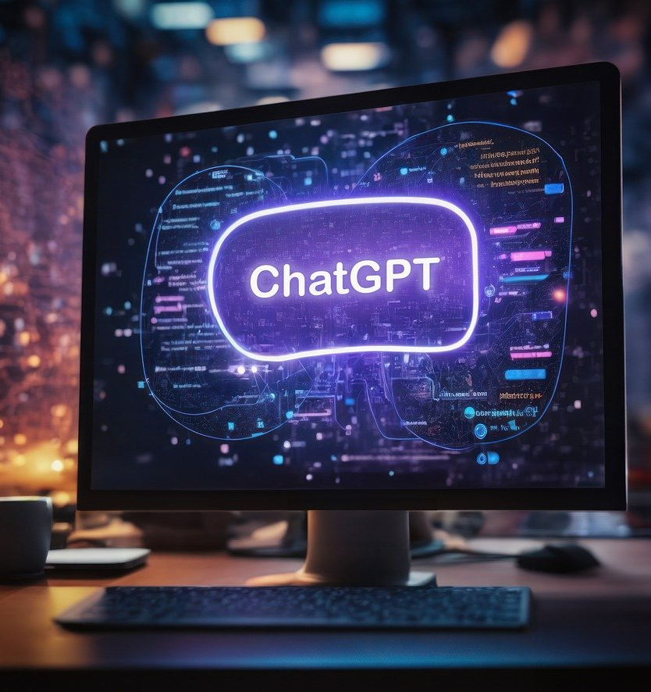
What is GenAI?
Generative AI (GenAI or GAI) is a type of artificial intelligence that uses machine learning algorithms to produce, copy or rework content.
This content output can be:
text
imagery
audio
code
other formats
Notes:
Video: https://youtu.be/t9gmyvf7JYo
What is GenAI?
Generative AI (GenAI) is an Artificial Intelligence (AI) technology that automatically generates content in response to prompts written in natural language conversational interfaces. Rather than simply curating existing webpages, by drawing on existing content, GenAI actually produces new content. The content can appear in formats that comprise all symbolic representations of human thinking: texts written in natural language, images (including photographs to digital paintings and cartoons), videos, music and software code. GenAI is trained using data collected from webpages, social media conversations and other online media. It generates its content by statistically analysing the distributions of words, pixels or other elements in the data that it has ingested and identifying and repeating common patterns (for
example, which words typically follow which other words). Guidance for generative AI in education and research by UNESCO is licensed under CC BY-SA 3.0 \
What is GenAI?
And now, as of November 2022, ChatGPT is the newest tool to come into the spotlight. The GPT in ChatGPT stands for “Generative Pre-trained Transformer”, referring to a type of machine learning called a neural network (learn more here or here) in which a computer learns to perform some task by analyzing training examples. In this case, the training data used by ChatGPT 3.5 is a dataset that includes 570GB of data from sources like books, Wikipedia, articles, and other pieces of writing on the internet up to 2021. The training methods for ChatGPT 4.0 has not been revealed as of yet. ChatGPT is now a famous name because it is a public-facing tool that allows anyone to generate text based on prompts for free (although a paid version is also available). Fundamentally, tools like ChatGPT are designed to take user prompts and use them to generate a response it believes the user would like to see. The AI tool(s) have no concept of fact or accuracy. They simply look for patterns in their training data, then produce what they think is the next most likely word or phrase. It’s also important to keep in mind, that giving the same prompt to the same generative AI tool does not always produce the same result. Each time a tool like ChatGPT is prompted, it creates a new output. While there will probably be similarities between outputs from the same prompt, they will not be the same every time. This is even more apparent when you use the same prompt across multiple AI products. Teaching in the Age of AI by the Center for Teaching at Vanderbilt University is licensed under CC BY-NC 4.0

Slide 5
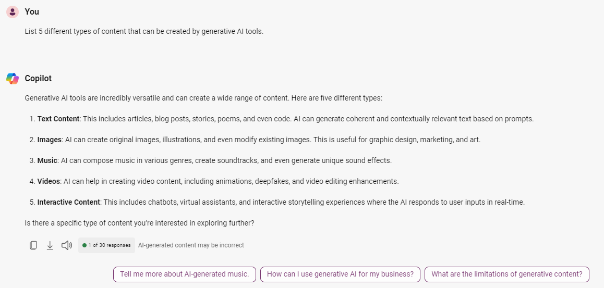
User prompt
Model
(e.g. ChatGPT4o)
GenAI output
Conversation with Copilot, August 2024

Slide 6
GenAI in your profession
Read and then delete
Facilitate a discussion around this topic.
How has AI impacted your discipline/profession?
What AI skills will you need as you enter the workforce?
Photo by Rawpixel
Notes:
Future of Jobs Report (2023): https://www3.weforum.org/docs/WEF_Future_of_Jobs_2023.pdf?_gl=1*19ubrm7*_up*MQ..&gclid=CjwKCAjwjaWoBhAmEiwAXz8DBQ7_9vypwVThhXUyS8_xzwBnHiPBP6dXnXtZMrrXI4-fFtgkusqMGhoCTuEQAvD_BwE

Slide 7
Limitations of GenAI
Read and then delete
Facilitate a discussion around this topic. Consider using an interactive activity such as Padlet, MS Whiteboard, poll etc.
What are some limitations of GenAI tools?
What concerns are there surrounding GenAI?
Photo by Rawpixel
Notes:
Future of Jobs Report (2023): https://www3.weforum.org/docs/WEF_Future_of_Jobs_2023.pdf?_gl=1*19ubrm7*_up*MQ..&gclid=CjwKCAjwjaWoBhAmEiwAXz8DBQ7_9vypwVThhXUyS8_xzwBnHiPBP6dXnXtZMrrXI4-fFtgkusqMGhoCTuEQAvD_BwE

Slide 8
Limitations of GenAI (1)
Misinformation: GenAI tools make stuff up (including quotes and references) (CNN)
Bias and harm: The output it produces can be biased, offensive and perpetuate stereotypes (The Conversation)
Copyright concerns: ChatGPT uses material taken from the internet, generally without the permission of the authors. It has been argued that ChatGPT is "copyright laundering" -- "making works derivative of existing material without breaking copyright". In December 2023 the NYTimes sued OpenAI and Microsoft for copyright infringement.
Photo by Rawpixel

Slide 9
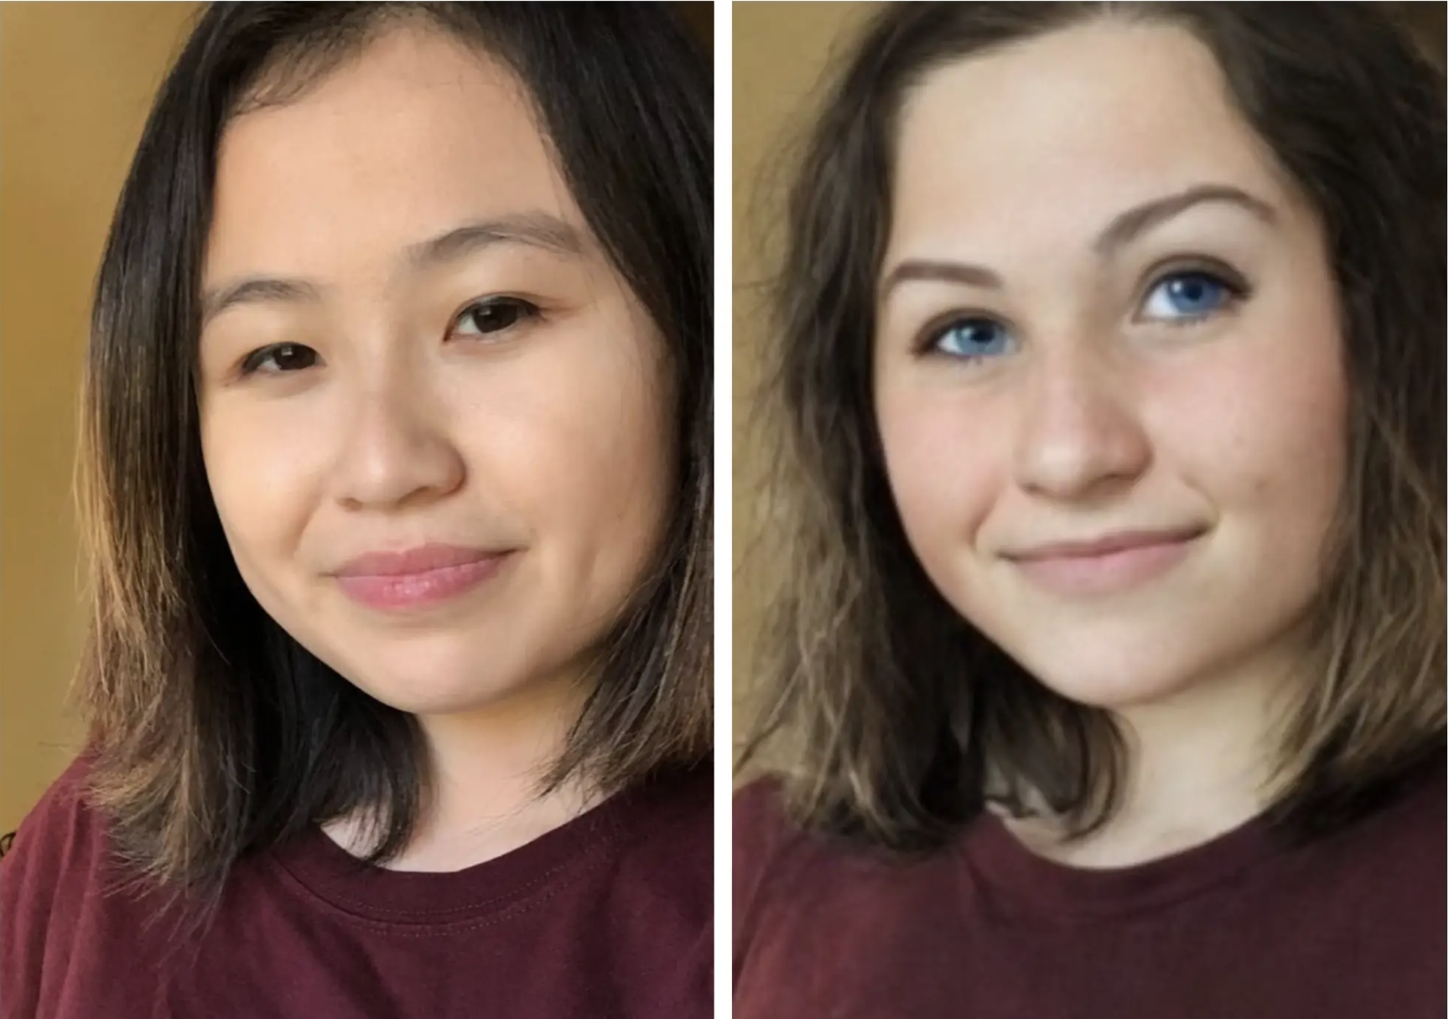
An Asian MIT student asked AI to turn an image of her into a professional headshot. It made her white, with lighter skin and blue eyes.
Bhaimiya, S. (2023, August 1). An Asian mit student asked AI to turn an image of her into a professional headshot. it made her white, with lighter skin and blue eyes. Business Insider. https://www.businessinsider.com/student-uses-playrgound-ai-for-professional-headshot-turned-white-2023-8
Notes:
Some improvements are being made in results due to refinement. However, the bias can still be deeply embedded.

Slide 10
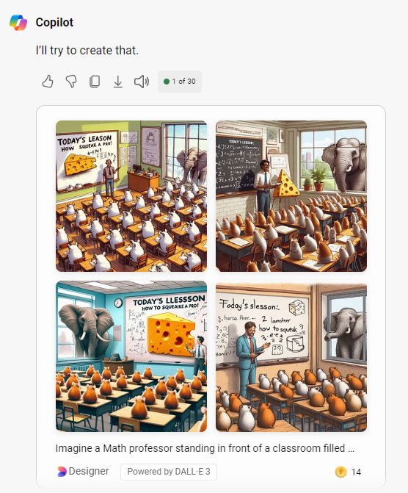
All of these options show a male Math teacher.
Notes:
Some improvements are being made in results due to refinement. However, the bias can still be deeply embedded.

Slide 11
Limitations of GenAI (2)
Legal/ethical issues: pasting protected info into GenAI apps
It may be unlawful to enter material using the chat function of a GenAI app if the material is protected by laws, such as:
privacy laws
intellectual property laws
confidential (e.g., by a court order)
Most GenAI apps use the information we input to further train their technology, and may reproduce what we enter for other users
Privacy: many GenAI tools require an account (and therefore collects data)
All LLM prompts and inputs work to help the AI tool evolve…
the technology is still new and many questions are being asked about the ethics of AI and the practices of companies like OpenAI
Photo by Rawpixel

Slide 12
Using GenAI in this course
Read and then delete
Although there is always space for exploration and experimentation, incorporation of GenAI into teaching and learning should be purposeful and in alignment with fundamental learning objectives and/or skills for job readiness. As with all course expectations, clear communication is key.

Slide 13
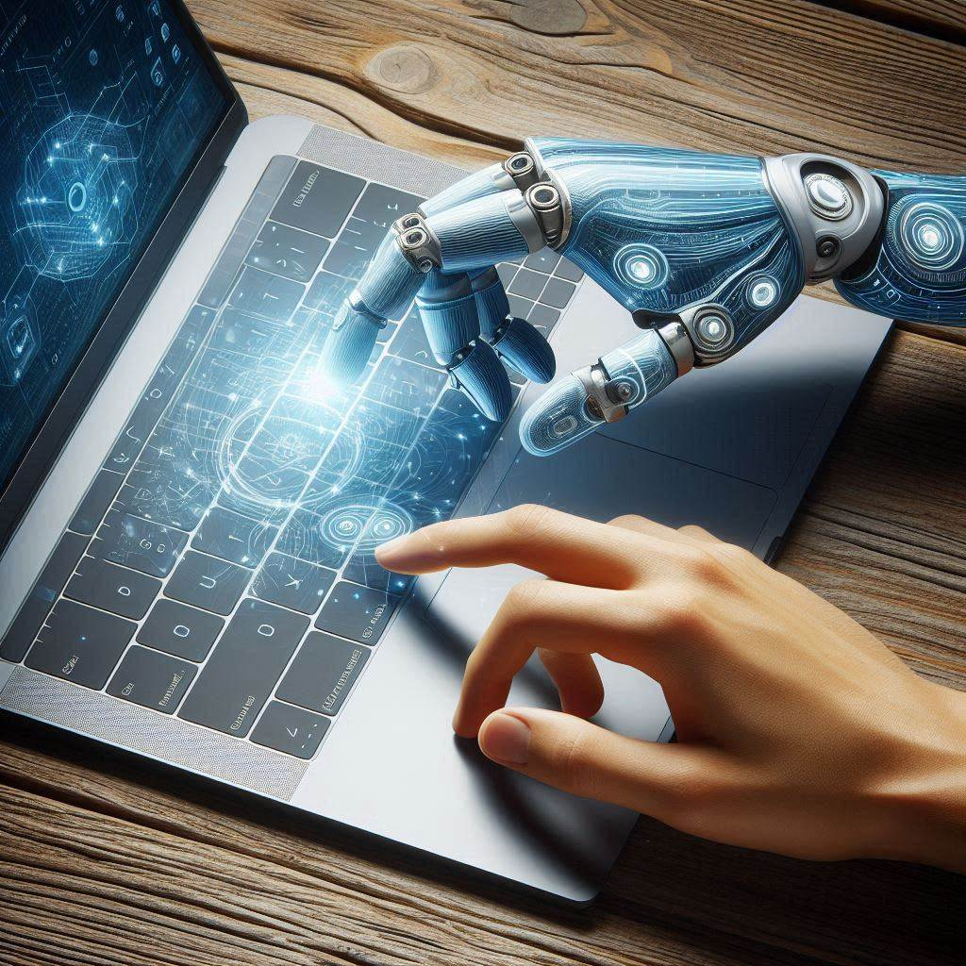
Academic Misconduct
Misuse of GenAI tools, including ChatGPT, Gemini, Copilot or other AI writing tools, to complete an assignment may be considered academic misconduct. It would be considered
Using content generated by AI and claiming it as your own work is considered contract cheating. Contract cheating is defined as: “[a] third-party completing work, with or without payment, for a learner, who then submits the work as their own, where such input is not permitted.” AA48: Academic Integrity policy. Learn more at Generative AI and Academic Misconduct
Created with Copilot: Prompt: Create an image featuring a human hand interacting with a laptop, where the hand is replaced with a more realistically rendered human hand while maintaining the essence of the original image which shows a juxtaposition of human and artificial intelligence.

Slide 14
Using GenAI in your courses
THE USE OF GENERATIVE AI IS PERMITTED IN THIS COURSE
THE USE OF GENERATIVE AI IS PERMITTED IN SPECIFIC COMPONENTS OF THIS COURSE
THE USE OF GENERATIVE AI IS NOT PERMITTED IN THIS COURSE
Notes:
Three possible outcomes. Choose one and communicate to students.
Focus on the conversation and why you have made this decision….
Set the expectation early on
You can adapt these use statements for your weekly schedule and assignment instructions: https://www.algonquincollege.com/lts/ai/sample-statements/
https://www.algonquincollege.com/lts/files/2023/08/Generative-AI-Exemplar-Assignment-Instructions-Rubric.docx

Slide 15
Using GenAI in your courses
Faculty responsibilities
Provide transparent communication on each assignment about if/how/why you can use GenAI
Provide alternatives to address concerns and/or access issues (you will not be mandated to use AI)
Eg: public version of Copilot and ChatGPT4o mini that does not require account creation
Provide support around effective use of the tools
Share support resources
Read and then delete
It’s very important for students to understand what your faculty responsibilities will be. This slide is meant to be communicated to students.
Notes:
Why (for your future employment you will need to know how to responsibly, effectively and ethically use AI)
Explain to students WHY you are using the tool - Think how you will introduce the tool. What knowledge & skills will they gain? Why is it important to them? What are their current and future benefits?

Slide 16
Assignment Guidance
GenAI is permitted for this assignment.
Details will be included
GenAI can be used in specific ways
Details will be included
GenAI is not permitted on this assignment
Details will be included
Read and then delete
Faculty, for each assignment in your course, let students know that you will share the appropriate GenAI assignment guidelines.
See GenAI assignment statements to use/adapt assignment guidance statements

Slide 17
Acknowledging use of GenAI
Assignment Instructions
Very briefly explain how you used GenAI in the production of this assessment.
Explain which AI tools you have used and for what purposes.
If you used tools on your own, explain why these tools were selected and provide a URL link to the tool.
Describe how the tool was used
Describe what output from the tool/service has been included, and where.
Summarize how you edited, adapted, and incorporated the AI output.
Also, it is recommended that you also carefully document the processes you used to create your assignment.
Attribution Statement I acknowledge the use of ChatGPT (https://chat.openai.com/) to refine the academic language and accuracy of my own work. On 4 January 2023 I submitted my entire essay (document shared) with the instruction to “Improve the academic tone and accuracy of language, including grammatical structures, punctuation and vocabulary”. The output (prompt results shared) was then modified further to better represent my own tone and style of writing.
Read and then delete
You may wish to discuss how you would like students to acknowledge their use of GenAI in assignments. This can be a simple acknowledgement statement or more formal citation of use. Also, describe if they should be documenting their work in a certain way.
Image from Freepik

Slide 18
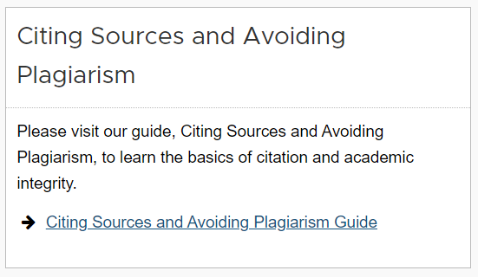
Acknowledging use of GenAI
Citation
Use the citation guide provided by Algonquin College’s library:
Read and then delete
You may wish to discuss how you would like students to acknowledge their use of GenAI in assignments. This can be a simple acknowledgement statement or more formal citation of use. Also, describe if they should be documenting their work in a certain way.
https://algonquincollege.libguides.com/generativeai/citing
Image from Freepik

Slide 19
Help Resources
When in doubt, ask!
Seek guidance from your professors if you have any questions or concerns about the use of AI tools in an assignment.
Need assistance?
Student Learning Centre offer workshops and appointments to support you with using GenAI, preparing research assignments, and citing your work Library has citation guides for how to cite GenAI use in your assignments
Remember, GenAI permissions will be different for each class. Be sure you understand the situation for each of your courses!!

Slide 20
Continuing the conversation …
Read and then delete
Ensure your students that this is just the beginning of an ongoing conversation as you all learn about the potential and limitations of AI in your course. Be sure to ask for feedback and input along the way!

