Slide 1
Mobile Application Design and Development
Diploma
2 Years
Ottawa
algonquincollege.com/madd

Slide 2
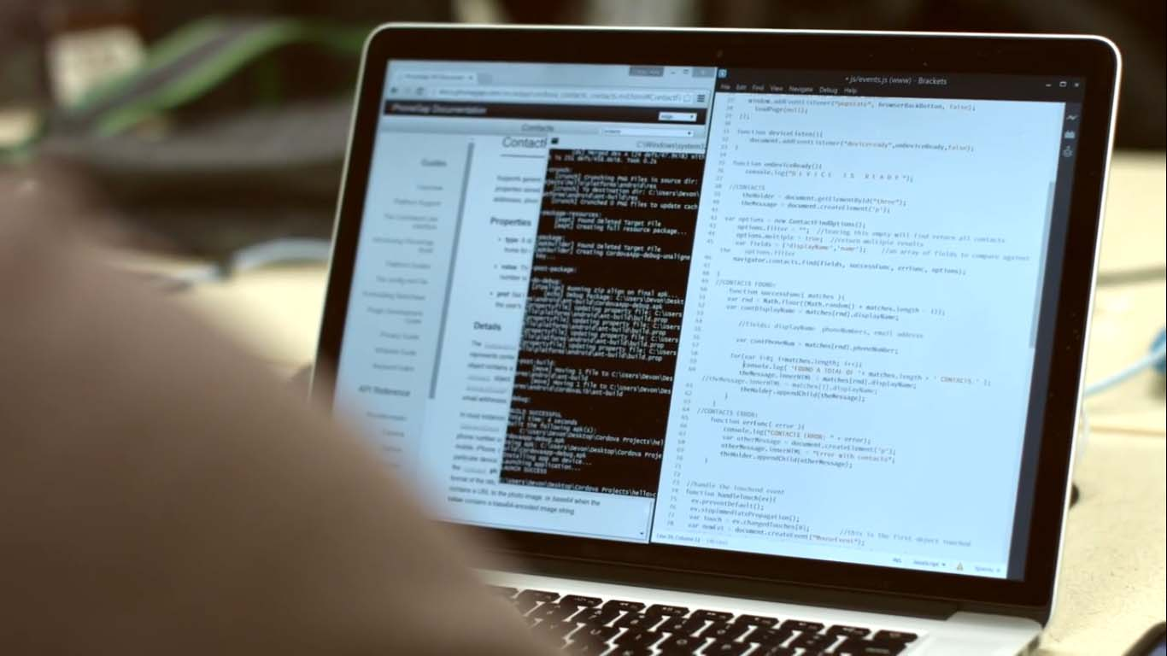
Agenda
Introductions
Program Overview
Program/Course Progression
Course Content / Course Work
Equipment Requirements
Student Experience & Grad Success
Program Resources & Support
Final thoughts / Learn More

Slide 3
Overview
Full-time program (no part-time option)
Fall (September start) and Winter (January start) intakes available
Program accepts approximately 68 students
Learn how to design and build full stack web applications, plus cross-platform and native mobile applications.
Program covers Development skills, UI and UX Design skills, plus marketing skills in a hands-on project-based environment.

Slide 4
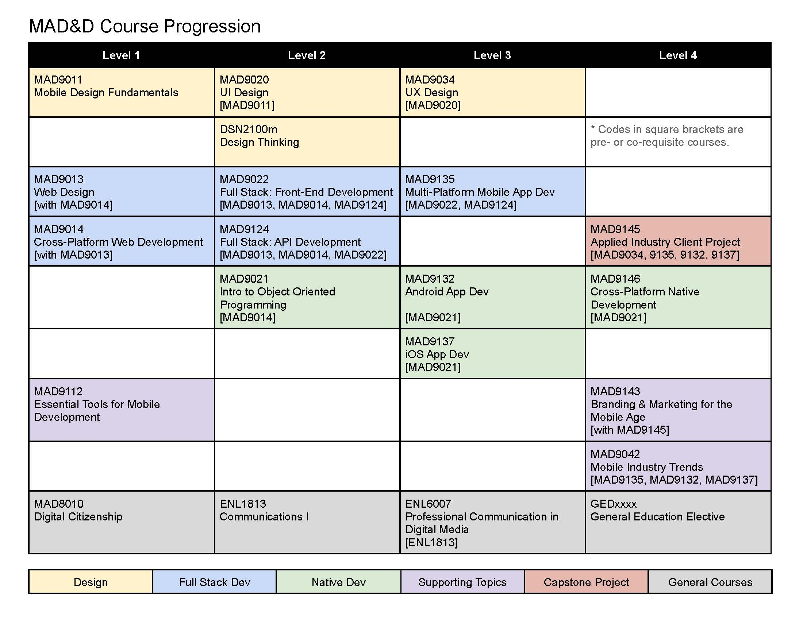
Program Progression (Courses)

Slide 5
Equipment Requirements
MacBook Pro (M1/M2/M3/M4 Pro or greater)
Android or iOS device that is no more than two years old
USB-C adapter Hub
Headphones
Parallels (Business or Developer edition)
Windows 11
Most up to date requirements can always be found at algonquincollege.com/byod

Slide 6
Course Content
Prepares you to enter the expanding and evolving fields of mobile web and application development.
You’ll experience working in teams and participate in the analysis, design, implementation, testing and deployment of your mobile solution.
In your final semester, prepare for industry by developing a real-world solution for a live client
Curriculum is updated every year
We aim for the leading edge so our graduates are well positioned to be leaders in the industry.
Notes:
Maybe we can talk about the program differences here vs giving them their own slide?

Slide 7
Course Materials
Progressive web app development
Native movie application development
Cross-platform application development
User interface (UI) design
User experience (UX) design
Responsive web design
Full stack
Smart AI and Machine Learning
Context-aware AI (RAG and Agentic Principles)
Business and marketing skills
Notes:
Maybe we can talk about the program differences here vs giving them their own slide?

Slide 8
Course Work
No Textbooks (technology changes too fast for this to be practical)
No Exams (technology best learned through hands-on application and practice)
No prior design or development experience required
NOT to be taken while working full-time. Expect 20 hours of class time each week, with an additional 20 hours of project work each week

Slide 9
Student Experience
“When you graduate, you'll have the tools and skills to learn how to build virtually anything you can dream up. This was my original goal when entering the program two years ago and today I feel ready to tackle any development challenge that comes my way.”
“If you are passionate about programming and you want to supplement your skills with design to be a better developer, then MAD&D will give you this perfect combo.”
Notes:
I’ve included this piece in the hopes that maybe we can get a current or former student to join us to talk about their time in the program

Slide 10
Grad Success
Anecdotal numbers from the last three graduating years:
20-25% find a job by the end of their classes
40-60% within a month of graduating
70-80% within two months of graduating

Slide 11
Mobile Software Development (iOS/Android/ Cross-Platform)
Demand: Strong and steady. Essential for businesses needing dedicated mobile applications for consumer services, internal tools, entertainment, and e-commerce. Demand exists for both native (iOS/Android) and cross-platform (React Native, Flutter) developers.
Job Titles: Mobile Developer, iOS Developer, Android Developer, Mobile Application Developer, React Native Developer, Flutter Developer, Software Engineer (Mobile).
NOC Code: Primarily falls under NOC 21232 - Software developers and programmers.
Salary Ranges (Estimates - CAD):
Entry-Level (0-2 years): $60,000 - $85,000
Mid-Level (2-5 years): $80,000 - $120,000
Senior-Level (5+ years): $110,000 - $160,000+
Required Skills:
Native: Swift & Objective-C (iOS), Kotlin & Java (Android), Xcode, Android Studio.
Cross-Platform: React Native (JavaScript/TypeScript), Flutter (Dart).
General: Mobile UI/UX principles, API integration (REST, GraphQL), version control (Git), testing, mobile platform guidelines.
Outlook: Job Bank Canada typically rates prospects as "Good" to "Very Good" in major provinces. Consistent demand is expected.

Slide 12
Full Stack Web Development
Demand: Extremely high. Full stack developers are highly versatile, capable of working on both front-end (client-side) and back-end (server-side) development. Needed by companies of all sizes for building and maintaining web applications.
Job Titles: Full Stack Developer, Web Developer, Software Engineer, Software Developer, Front End Developer (often with back-end knowledge), Back End Developer (often with front-end knowledge).
NOC Codes: Primarily NOC 21232 - Software developers and programmers and NOC 21234 - Web developers and programmers.
Salary Ranges (Estimates - CAD):
Entry-Level (0-2 years): $65,000 - $90,000
Mid-Level (2-5 years): $85,000 - $130,000
Senior-Level (5+ years): $120,000 - $180,000+
Required Skills:
Front-End: HTML, CSS, JavaScript (ES6+), TypeScript, Frameworks (React, Angular, Vue.js).
Back-End: Languages (Node.js, Python, Java, Ruby, C#, PHP), Frameworks (Express, Django/Flask, Spring Boot, Ruby on Rails, .NET Core, Laravel).
Databases: SQL (PostgreSQL, MySQL), NoSQL (MongoDB, Redis).
APIs: RESTful APIs, GraphQL.
DevOps/Cloud: Basics of AWS/Azure/GCP, Docker, CI/CD, Git.
Testing: Unit testing, integration testing.
Outlook: Consistently rated "Good" to "Very Good" across Canada, especially in tech hubs. Remains one of the most sought-after tech roles.

Slide 13
AI/ML Specialization: Retrieval-Augmented Generation (RAG) AI Development
Focus: A specialized area within AI/ML focused on building systems that enhance Large Language Models (LLMs) by retrieving relevant information from external knowledge bases (documents, databases) before generating a response. This improves accuracy, relevance, and reduces "hallucinations."
Demand: Extremely high and surging, particularly from companies implementing practical Generative AI solutions. These skills are scarce and highly valued.
Job Titles: Often embedded within broader roles like Software Engineer (AI/LLM), Machine Learning Engineer, AI Engineer. Specific titles like RAG Engineer may become more common.
Salary Ranges: Commands a premium over general AI/ML roles. Expect salaries towards the mid-to-high end or exceeding general AI/ML ranges.
Mid-Level (with RAG skills): ~$120k - $170k+
Senior/Specialist (proven RAG exp): ~$160k - $220k++
Required Skills (In addition to General AI/ML):
LLMs: Deep understanding of prompting, APIs (OpenAI, etc.), open-source models.
Vector Databases: Experience with Pinecone, Weaviate, ChromaDB, Milvus, etc.
Embeddings: Sentence Transformers, OpenAI Embeddings, etc.
Information Retrieval: Chunking, indexing, ranking techniques.
Frameworks: LangChain, LlamaIndex.
Integration: Strong software engineering for pipeline construction.
Outlook: Excellent. A high-growth niche critical for practical LLM deployment.

Slide 14
AI/ML Specialization: Agentic AI Development
Focus: Another cutting-edge AI/ML specialization focused on creating AI systems (often LLM-based) that can autonomously reason, plan, use tools (APIs, code execution, web browsing), and execute sequences of actions to achieve complex goals.
Demand: Extremely high, especially from advanced AI research labs, startups building autonomous agents, and companies exploring sophisticated AI-driven automation. Expertise is rare.
Job Titles: Often under Software Engineer (AI/Agents), Machine Learning Engineer, Research Engineer. Titles like AI Agent Developer might emerge.
Salary Ranges: Commands a significant premium, similar to or potentially exceeding RAG roles due to complexity and novelty. Expect salaries at the high end or exceeding general AI/ML ranges.
Mid-Level (with Agentic skills): ~$130k - $180k+
Senior/Specialist (proven Agentic exp): ~$170k - $230k++
Required Skills (In addition to General AI/ML):
LLMs: Mastery of advanced prompting (Chain-of-Thought, ReAct), function calling, model orchestration.
Agent Frameworks: LangChain Agents, AutoGen, CrewAI, custom frameworks.
Planning & Reasoning: Implementing agent decision-making logic.
Tool Use: Integrating external tools (APIs, code interpreters) securely and effectively.
System Design: Building robust, stateful, and error-tolerant agent systems.
Evaluation: Developing metrics for agent performance.
Outlook: Excellent. A highly experimental but potentially transformative field with enormous growth potential.

Slide 15
Software Development / Machine Learning Engineering (General)
Demand: Very high and rapidly growing. Driven by the integration of AI and ML across nearly every industry. Roles focus on designing, building, deploying, and maintaining ML models and the surrounding software infrastructure.
Job Titles: AI Developer, Machine Learning Engineer, Software Engineer (AI/ML), Computer Vision Engineer, NLP Engineer, AI Research Engineer, Data Scientist (with engineering focus).
NOC Codes: Primarily NOC 21232 (Software developers and programmers). Can overlap with NOC 21211 (Data scientists).
Salary Ranges (Estimates - CAD, often higher with advanced degrees/specialization):
Entry-Level (Often needs Masters/strong portfolio): $75,000 - $100,000+
Mid-Level (2-5 years relevant exp): $100,000 - $150,000
Senior-Level (5+ years): $140,000 - $200,000+ (Significantly higher possible at top firms/labs).
Required Skills:
Programming: Python (dominant), possibly C++, Java.
AI/ML Libraries: TensorFlow, PyTorch, Keras, scikit-learn. Domain-specific libraries
(e.g., Hugging Face Transformers, OpenCV).
Data Handling: Pandas, NumPy, SQL/NoSQL, data pipelines.
ML Concepts: Algorithms, deep learning, model evaluation, statistics.
Software Engineering: Strong fundamentals (data structures, algorithms, testing, Git, system design).
Cloud: ML services on AWS (SageMaker), Azure ML, GCP (Vertex AI).
MLOps: Model deployment, monitoring, versioning (MLflow, Kubeflow, Docker, CI/CD).
Outlook: Very Good to Excellent. Strong continued growth expected as AI adoption accelerates.

Slide 16
Program Resources & Support
Free online prep course to help students prepare for the semester and to start their own program related learning
Program assistants in first year
In August, all students are invited to join our Slack Workspace
Quickstart AMA sessions held in August to answer questions before the semester begins

Slide 17
Learn More
Visit our program page at algonquincollege.com/madd
International students can learn more through our International Education Centre - algonquincollege.com/international/
Watch for our AMA’s on the Algonquin College subreddit - https://www.reddit.com/r/Algonquin_College/
Learn more about the many support systems the college offers - algonquincollege.com/studentsupportservices/

Slide 18
Thank you!

