Slide 1
Welcome
to
Student Information for Medical and Non-Medical Requirements

Slide 2
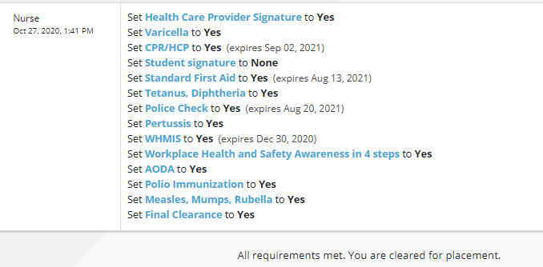
What is Placement Pass?
A secure web portal that enables students to upload records and documents.
Allows ParaMed nurses to review and to determine whether students have met the requirements for placement.
Through this web portal college administrators and faculty can see that the students are cleared for placement.

Slide 3
The Student Process- Getting Ready
Student goes to the College assigned website
Book an appointment with a Health Care Provider
Documents the student brings to the appointment
Creates an account
Prints the pre-placement health form
Can also send questions to the ParaMed nurses using the “get help” button
The Health Care Provider (HCP) will:
Complete the TB screening
Review and update immunizations
Order lab blood tests and Chest X-Rays if required
Vaccine records such as:
Yellow immunization cards
Booklets
Medical clinic printouts
Notes from HCPs
Public health or health board documents

Slide 4
What is an immunization record?
Is a record of some or all of the vaccines you have received.
An official record should include:
Student name
Name of vaccine and date administered
Name of HCP who gave the vaccine or supervised the administration
Can be a card, booklet, printout, note from a physician or nurse, a public health or health board document.
A vaccine record is required for every vaccine recorded on the health.

Slide 5
Students who do not have vaccine records
May be required to receive additional vaccines called an “adult series”
Examples include Tetanus (Td) and Polio
Some requirements can be cleared with blood test results that show full immunity or “Reactive” response
Examples include MMR and Varicella

Slide 6
COVID-19 Vaccine
How it affects other vaccines and TB testing
As recommended by the National Advisory Commission on Immunization in an update published September 28, 2021 ((NACI) COVID-19 vaccines may be given at the same as, or any time before or after, other vaccines, including live, non-live, adjuvanted or unadjuvanted vaccines. The same rule applies to TB testing and influenza vaccine.

Slide 7
Medical Requirement
Tuberculosis Screening
Used to identify students who may have had an exposure to TB.
Is an annual medical requirement for placement.
If a student has never had a 2-Step TB skin test, they will need a 2-Step TB skin test (TB skin test on each arm).
If the results are negative, a 1-Step TB skin test can be done next time required.
A result is positive if a bump 10mm or larger develops.
With a positive result, student needs to have a Chest X-Ray and physical exam, these students are exempt from further skin tests.
The HCP needs to sign the TB page of the pre-placement health form, (annual requirement).
Students need to include the X-Ray report with their submission.

Slide 8
Medical Requirement
Measles, Mumps, Rubella and Varicella (chicken pox)
The student must provide:
An immunization record to verify that they have received two doses of the MMR and Varicella vaccine
OR
A lab blood test showing full immunity

Slide 9
Medical Requirement
Tetanus / Diphtheria (Td)
Pertussis (Tdap)
The student must provide vaccine records:
Showing dates of immunization
There is no blood test that shows immunity
If no vaccine records available, the student must receive an adult series (3 doses) and can be given a temporary exception after submitting dose #2
Pertussis is given as part of the tetanus vaccine- called Tdap
The student will require an adult booster dose of Pertussis (Tdap) vaccine. This is in addition to the adolescent dose
This is an extra requirement for students in health care and education sector and community placements

Slide 10
Medical Requirement
Polio
The student must provide vaccine records:
Showing dates of immunization
There is no blood test that shows immunity
If no vaccine records available, the student must receive an adult series (3 doses) and can be given a temporary exception after submitting dose #2

Slide 11
Medical Requirement
Hepatitis B
Students must provide lab results for Hepatitis B antibody (immunity)
Antibody lab results of 10 IU/L or higher indicate immunity.
Vaccine records required for all Hepatitis B vaccine received.
When blood test shows immunity less that the recommended level:
Need a booster dose of Hepatitis B vaccine
Follow up blood test in 1 month
Student may be given a temporary exception by submitting the booster vaccine record
Students who are in the process of receiving the full 3 dose series can be given a temporary exception after submitting dose #2.
Students can receive up to 6 doses of vaccine in total.

Slide 12
Medical Requirement
Influenza
The flu season is between October and end of April, this is when the flu vaccine is available. Refer to your pre-placement health form for details for your program as this is a mandatory requirement for some placement facilities.
If a student has a medical condition which prevents them from receiving a flu vaccine, a doctor's note is required.
The ParaMed nurse will record this as a permanent exception and the student needs to discuss this further with their program coordinator
Flu vaccine records can be submitted any time without an additional fee.

Slide 13
Medical Requirement
COVID-19 Vaccine
It is mandatory to be fully vaccinated for COVID-19
Dose #1 and #2 with an accepted Canadian vaccine or
1 dose of the J&J vaccine
Many placement facilities now require a COVID-19 booster dose as well. This is Mandatory for all student placements going into Long Term Care facilities in Ontario.
This requirement is subject to change as directed by the Ministry of Health
If student is unable to receive vaccine due to a medical condition:
a physician or nurse practitioner will need to request, in writing, a medical exemption following the current NACI guidelines.
the student will be assigned a "Permanent Exception” and not cleared.
Students are required to discuss their non-clearance status with their program coordinator
Unvaccinated students may not be eligible to attend clinical placement and therefore this may impede my progression through the program of study.

Slide 14
Non-Medical Requirement
CPR
Standard First Aid
Check required level and expiry date per the policy of the program. This is located on pre-placement health form- non-medical requirements page. Must remain valid until the end of the academic year.
3 types available: CPR C, CPR HCP and CPR BLS.
BLS is highest level
Emergency First Aid is not equivalent
Online CPR/ Standard First Aid Certificates are not accepted without an in-class instructor lead practice component
If a blended or hybrid program is taken, the student will need to submit the final certificate indicating they have completed both the on-line theory portion as well as the in-class instructor portion

Slide 15
Non-Medical Requirement
Mask Fit Testing
N95 masks are called Respirator masks:
Must be fit tested to ensure they offer the proper fit and protection with no air leaks for your shape of face.
In Canada, we follow standards set out by National Institute for Occupational Safety and Health-NIOSH and Health Canada.
Your program will provide guidance on the mask types appropriate for your placement. Certificate valid for 2 years.
Students requesting exemptions- will need to discuss with your program coordinator

Slide 16
Non-Medical Requirement
Police Record Checks
Make sure to apply for the correct type - refer to the pre-placement health form for details.
Vulnerable Sector Police Check (level 3):
Most in depth - shows criminal convictions, pending charges, special charges. Can be local or provincial police departments- the department that has jurisdiction where you live.
Some police departments require a letter from the school program to request a vulnerable sector police check.
Most police departments now have an online process. Some departments require the student to click on “Verify Digital Signature” once the emailed police check is opened. The Digital Signature is required.
Expiry date is set by the program- located on the pre-placement health form. Do not delay in applying as this process can take a long time
Basic Criminal Checks (level 1) - Only required by programs that do not expose the student to vulnerable clients.
Not Accepted:
Third party back checks- Arranged by employers and external companies. Does not include all the information required on a vulnerable sector police check

Slide 17
Non-Medical Requirement
Other Certificates
WHMIS
Ontario Workplace Health and Safety Awareness
Workplace Violence and Harassment
AODA
College Placement Student Agreement
Student needs to refer to their pre-placement health form, non-medical requirements page for a full list

Slide 18
What documents does the student submit?
The full clinical field placement health form
Reviewed and signed by the health care provider
Student to sign the student agreement page
Submit as one file not each page as a separate file
Vaccine records for every date that is on the health form including the most recent doses administered
Results of blood tests
Chest X-Ray report (if required)
Other certificates and documents such as first aid, CPR, police record check etc.
18

Slide 19
How to Submit Documents?
It is recommended students download a free mobile scanning APP onto their phone.
Allows the user to scan documents accurately and clearly.
Upload documents to the Placement Pass website saved in PDF format. Easy for the student to also save their records on their own device for future reference- very important when applying for jobs.
Can upload multiple documents in one file. For example, the full pre-placement health form in one file.
More secure as personal health information not stored on photo roll of student's phone.
Examples of free APPs for mobile devices: Adobe Scan, Camscanner or Scan Bot.
Go to Google Play Store or Apple App Store to download easily to your phone.

Slide 20
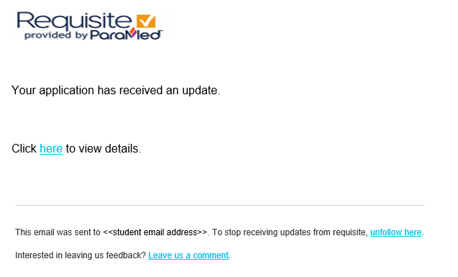
Student Submissions
When the student has completed their requirements, has all their records, lab tests, certificates and their health form (signed by a Health Care Provider), they are ready to pay their fee and upload their documents
Every time an entry or comment is made on a student account, they receive an email advising them to log onto the website and check their account activity

Slide 21
Checking Your Status following Submission
Once the submission has been reviewed:
The student can access a printable Status Report
Can be provided to the student’s HCP, detailing any deficiencies from the submission
Can be shared with their Placement facility which will show the status of the clearance requirements
To access the status report, click on the link at the top of the page (beside receipts)
The most recent status report that represents the latest nurse review will show at the top of the page, highlighted in blue

Slide 23
Thank you for listening.
Please let your program coordinator know if you have any questions.

